Slide 1
Tribal Medi-Cal Administrative Activities (TMAA)
Sarah Ponnequin, BS
Program Analyst
Koe-Soes Vigil, BS
TMAA Coordinator, California Rural Indian Health Board, Inc.
Notes:
Good afternoon, my name is Sarah Ponnequin and I am the Program Analyst for the Health Systems Development Department at CRIHB.
I have been at CRIHB for about 15 years and have worked on several different projects including TMAA.
Today, we are going to go over the Tribal Medi-Cal Administrative Activities Program.

Slide 2
Presentation Overview
History of the TMAA program
History of TMAA
Purpose of TMAA
CRIHB’s Role
Who Can Participate
TMAA Program
Program Overview
What is Required to Participate/1st Steps
Changes
Transportation specific services
Medi-Cal Administrative Activities specific services
Claiming Process
Medi-Cal Fee-for-Service (FFS) Beneficiary NMT claiming/billing process
Website & Contact Info

Slide 3
History of the TMAA Program in California

Slide 4
History of TMAA
2009
State law was amended to include Tribes, Tribal Health Programs (THPs), and Tribal Organizations as participants in the MAA program.
2009
Began implementation of NMT provided by Tribes and THPs.
CRIHB became the sole contractor with the state to administer TMAA for all Tribes in California.
2009
CRIHB learned about a federal program called Medicaid Administrative Match (MAM) and decided California Tribes should participate.
2003
Notes:
TMAA is a federal program administered through the state of California by the Department of Health Care Services. The federal name for this program is called MAM- which stands Medicaid Administrative Match. As you know, California is its own little country and calls the federal program MAA-Medical Administrative Activities.
We first heard about Tribal MAA from a joint meeting with the Northwest Portland Area Indian Health Board and decided that we would also like to participate in this program.
In order for us to participate in the program, state law needed to be amended to include Native American Indian Tribes, Tribal Organizations, and Tribal subgroups as participants in MAA.
So, in 2003, state law was amended.
In 2004, DHCS began the development of the TMAA program implementation plan for federal approval.
The official TMAA program implementation Plan was developed by DHCS in consultation with CRIHB and the Centers for Medicare and Medicaid Services.
One of the main objectives in the beginning was to make TMAA a sustainable program which have managed to do.
We now have a new objective that we are working on which is to develop the Tribal Targeted Case Management Program which is now a bill that we working on getting passed.

Slide 5
History of TMAA (Continued)
2010
2010
TMAA was implemented.
CRIHB began processing TMAA claims and reimbursing CA Tribes, THPs, and Tribal Organizations.
2017
Changes due to Medi-Cal Managed Care, splitting claims process into Medi-Cal FFS and Managed Care.
2020
CRIHB reimbursed Tribes, THPs, and Tribal Organizations with over $10 million for Medi-Cal transportation and MAA-specific activities.

Slide 6
Purpose of TMAA
Increase enrollment in the Medi-Cal program and to reimburse THPs for services they have been providing to their members for years.
Form a partnership between DHCS and participating federally recognized Tribes, THPs, and Tribal Organizations.
Share responsibility for promoting access to Medi-Cal health care for American Indians and Alaska Natives (AIAN).
Reimburse Tribes, THPs, and Tribal Organizations for performing administrative activities allowed by the TMAA program. This was the first new funding that had come into CA Tribes in many years.
Serve all Medi-Cal clients, including Tribal and non-Tribal members.
Notes:
The goals of the MAA program are to:
Facilitate outreach to potential MediCal enrollees;
Assist children & families in accessing needed MediCal services;
Assist & support Tribes & Tribal Organizations to prepare apropriate claims for administrative costs under the MediCal program; and
Administer an effective, efficient statewide MAA program.

Slide 7
What is CRIHB’s Role in the TMAA Program?
CRIHB is the sole contractor for submitting TMAA Medi-Cal FFS claims with the state of CA.
Maintains TMAA records for auditing purposes.
Disburses TMAA reimbursement funds quarterly to THPs, Tribes, and Tribal Organizations.
Acts as an intermediary between participating Tribal programs and the state.
Gathers and processes TMAA claims on behalf of participating programs. Includes review of all travel logs, receipts, and timesheets. Prepares TMAA claims to be submitted to state of CA.
Notes:
CRIHB: For Medi-cal FFS transportation and MAA specific claiming
MCO: goes directly to the managed care plan for reimbursement
TMAA is a 3rd party reimbursement program so Tribes can use the funds any way they want, there are no restrictions on the funding and the Tribes will never be audited.

Slide 8
Who Can Participate in TMAA?
CA Federally Recognized Tribes (MOU required)
CA THPs
CA Tribal Organizations
Notes:
The goals of the MAA program are to:
Facilitate outreach to potential MediCal enrollees;
Assist children & families in accessing needed MediCal services;
Assist & support Tribes & Tribal Organizations to prepare apropriate claims for administrative costs under the MediCal program; and
Administer an effective, efficient statewide MAA program.

Slide 9
Participating Programs
Anav Tribal Health Clinic
Bear River Band of Rohnerville Rancheria
Bridgeport Indian Colony
Chapa-De Indian Health Program
Consolidated Tribal Health Project
Greenville Rancheria Tribal Health Program
Karuk Tribe Health & Human Services Program
K’ima:w Medical Center
Lake County Tribal Health Consortium
Lassen Indian Health Center
Mathiesen Memorial Health Clinic
Northern Valley Indian Health
Pit River Health Service
Redding Rancheria Tribal Health
Riverside San Bernardino County
Rolling Hills Clinic
Round Valley Indian Health Center
Sonoma County Indian Health Project
Strong Family Health Center
Toiyabe Indian Health Project
Tule River Indian Health Center
United Indian Health Services
Warner Mountain Indian Health
Yurok Tribe
Notes:
We have 24 participating programs, 10 of which are currently active.

Slide 10
TMAA Program
Notes:
Next, we will go over the information needed to become a TMAA Tribal Health program participant and the steps it takes ot get contracted

Slide 11
TMAA Program
The TMAA program consists of two parts
Transportation specific services
Medi-Cal Administrative Activities specific services
TMAA Reimbursement
100% of costs can be claimed for travel & MAA Specific Time
Staff Salaries
Employer Paid Benefits
Claims are reimbursed at 50%
Notes:
These are admin activities you are already doing, and it ties to the claiming plan. Only certain people listed on the claiming plan can claim those codes

Slide 12
Required for ALL Programs Participating in TMAA
1. Participation agreement or letter of intent
2. Two signed contracts:
MAA subcontractor agreement
MAA-specific agreement
3. Claiming plan
1. Duties statement
2. Organization charts
3. Indirect cost rates
4. Financial statements
4. Be enrolled in the DHCS PAVE system (for transportation only)
Notes:
Each THP who wishes to participate as a Transportation Provider must enroll into the DHCS PAVE system as a transportation provider.
The letter of intent is with CRIHB and lays out who can participate in the program
The 2 signed contracts are with CRIHB.
The Claiming Plan is to the State but CRIHB assists and it incudes things like a duties statement, org charts, IDC rate (formally negotiated with the Dept of the interior) and financial statements to show you are a 638 contractor

Slide 13
Changes to the TMAA Program in California

Slide 14
Change: Beginning November 2019, programs must submit a claim to CRIHB and/or MCP, depending on who insures the beneficiary.
Medi-Cal FFS (Invoice CRIHB)
Medi-Cal
MCP (Submit claim to MCP)
Is the Medi-Cal beneficiary enrolled in Medi-Cal FFS or Medi-Cal MCP?

Slide 15
What Does This Mean for TMAA?
Each participating THP may continue to provide transportation services.
Continue to log transportation activities as usual for members who are enrolled into Medi-Cal FFS.
Each THP will need to submit a claim to their local Medi-Cal MCP for transportation services to managed care beneficiaries.
Notes:
Partnership has provided guidance on billing for NMT services directly to the plan.
HealthNet and Anthem Blue Cross have not given guidance on what this looks like for them as of 2.25.2020

Slide 16
Medi-Cal FFS vs. Medi-Cal MCP
Develop an internal process for your organization to differentiate between Medi-Cal FFS (straight Medi-Cal) and Medi-Cal MCP beneficiaries.
Notes:
We will go over PAVE next https://pave.dhcs.ca.gov/sso/login.do?
The THP will need to identify whether the patient is Medi-Cal FFS or Medi-Cal Managed care and then follow the appreciate claims process

Slide 17
TMAA Transportation Medi-Cal FFS Beneficiaries

Slide 18
TMAA Transportation Program Medi-Cal FFS Beneficiaries (Claims Submitted to CRIHB)
TMAA
TMAA Medi-Cal FFS beneficiary claims (CRIHB)
Medi-Cal MCO beneficiary claims (not CRIHB)
TMAA transportation
TMAA-specific activities
Codes 4,6,8,14,16,17
(CRIHB only)
Reimbursement
100% of costs can be claimed
Claims are reimbursed at 50%

Slide 19
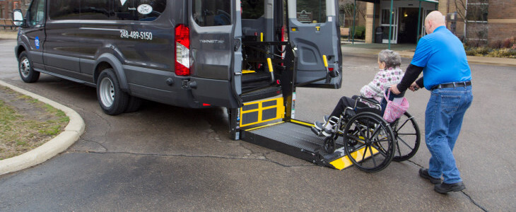
What Can Be Claimed for Medi-Cal FFS Beneficiaries?
TMAA Medi-Cal FFS Beneficiaries
The actual mileage cost of providing Non-emergency medical transportation (NEMT) and non-medical transportation (NMT)
100% of staff costs (salaries and benefits) for time spent transporting and/or accompanying the patient to a physician visit, including wait time.
The actual cost of lodging and meal stipends for the following individuals, if overnight travel is needed (policy must be in place):
Patient
Chaperone (if patient is a child, disabled, or elderly)
Transporter
Notes:
Lond distance/overnight specialty care visits can be claimed
Nothing has changed for beneficiaries who are enrolled into Medi-Cal FFS (straight Medi-cal).
Logs will still be required and claims sent to CRIHB for processing.

Slide 20
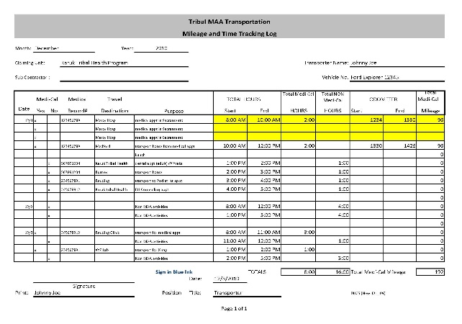
TMAA Transportation For Medi-Cal FFS Beneficiaries
TMAA transportation logs
Record the date of transportation activity
Log the medical record number to verify if patient is approved for Medi-Cal
Track the start and stop time for each Medi-Cal patient’s trip
Track the odometer for each Medi-Cal patient’s trip to calculate the mileage
Travel expenses
Lodging receipts for overnight trips
Timesheets for the 3-month period
Need the hourly wage and benefits paid by the THP for each employee
Indirect Cost Rate approved by the THP

Slide 21
Medi-Cal FFS Transportation Log

Slide 22
NEMT and NMT Transportation

Slide 23
NEMT and NMT Transportation
NEMT
NEMT can only be reimbursed with a prescription and is covered for Medi-Cal FFS beneficiaries under TMAA or through the MCP for managed care.
May include ambulance, wheelchair accessible vehicle, air transportation, and litter van.
NMT Services (PPL No. 18-019)
NMT is transportation by a private or public vehicle for people who do not have another way to get to their appointment.
Medi-Cal offers transportation to and from appointments for services covered by Medi-Cal, including transportation to perform administrative activities that directly support access to health care for beneficiaries.
TMAA and MCP both reimburse for NMT.

Slide 24
How to Claim?
For TMAA-specific activity claims, Medi-Cal FFS, and transportation (NMT) claims, go through the TMAA Coordinator.
Detailed salaries, benefits records, and mileage logs are submitted to the TMAA Coordinator for invoice completion.
Submit to Koe-Soes
Reviewed by CRIHB
Submit invoice to state
TMAA Coordinator compiles documentation
Payment is issued
Notes:
The Tribal MAA Contractor is the only entity that will submit the Tribal MAA Invoice to the Department of Health Care Services (DHCS) and is responsible for the preparation of the Tribal MAA Invoice and all backup and supporting documentation kept in the audit file. For invoices submitted for costs associated with the Tribal Organization and all subcontractors, the Tribal MAA Contractor will ensure receipt and review of all backup and supporting documentation prior to submission of the invoice to DHCS.

Slide 25
TMAA Claiming Medi-Cal Administrative Activities (MAA) specific

Slide 26
TMAA Administrative Activities Codes
TMAA
TMAA Medi-Cal FFS beneficiary claims (CRIHB)
Medi-Cal MCO beneficiary claims (not CRIHB)
TMAA transportation
TMAA administrative activities
Codes 4,6,8,14,16,17
(CRIHB only)
Code 4: Initial Medi-Cal Outreach
Code 6: Facilitating Medi-Cal application
Code 8: Ongoing referral, coordination, and monitoring
Code 10: Arranging transportation for Medi-Cal services
Code 14: Translation assistance
Code 16: Program planning, policy development, and interagency coordination
Code 17: MAA administration and claims coordination
Notes:
Code 6 when you’re helping the client with the application process, like verifying their eligibility, gathering income verification documents, providing forms, helping them submit their application, things like that.
Code 14 includes time spent translating pamphlets

Slide 27
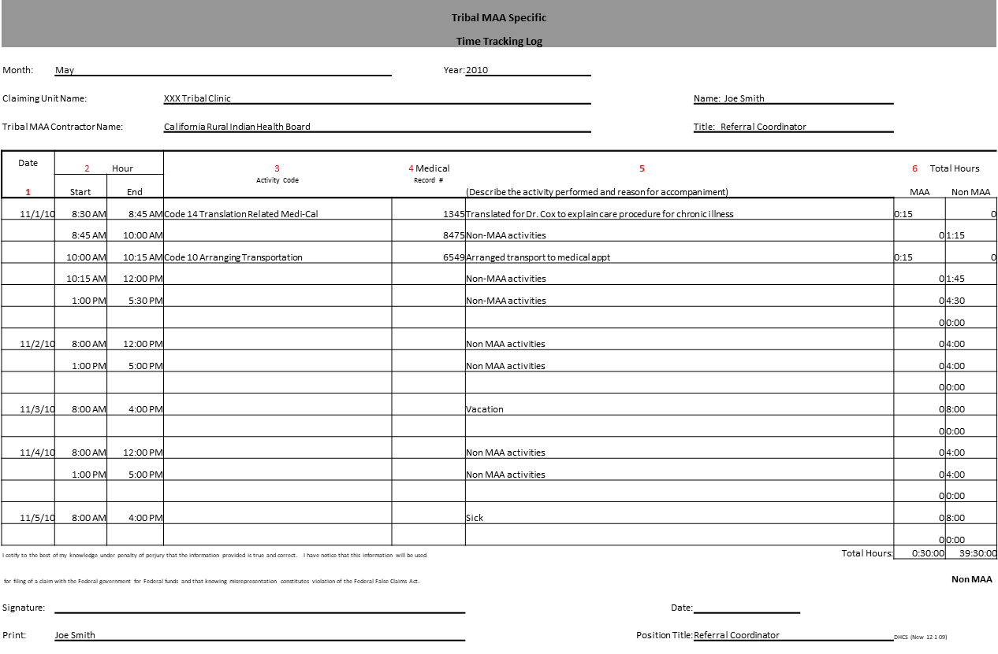
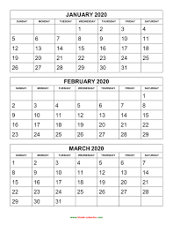
TMAA-Specific Activities Tracking Log
Time tracking log
Date of activity
Record the start time and end time for each TMAA activity
Use drop down menu for the activity code
Record the medical record number to verify the patient is approved for Medi-Cal
Describe the activity performed
Timesheets for the 3-month period
Need the hourly wage and benefits paid by the THP for each employee
Indirect cost rate approved by the THP

Slide 28
TMAA-Specific Activities Log
Tribal MAA Specific
Time Tracking Log
Month: | May |  |  | Year: | 2010
Claiming Unit Name: |  |  | XXX Tribal Clinic |  |  |  |  | Name: Joe Smith
Tribal MAA Contractor Name: |  |  | California Rural Indian Health Board |  |  |  |  | Title: Referral Coordinator
Date | 2 Hour |  | 3 | 4 Medical |  |  | 5 |  |  | 6 Total Hours
1 | Start | End | Activity Code | Record # | (Describe the activity performed and reason for accompaniment) |  |  |  |  | MAA | Non MAA
11/1/10 | 8:30 AM | 8:45 AM | Code 14 Translation Related Medi-Cal | 1345 | Translated for Dr. Cox to explain care procedure for chronic illness |  |  |  |  | 0:15 | 0
 | 8:45 AM | 10:00 AM |  | 8475 | Non-MAA activities |  |  |  |  | 0 | 1:15
 | 10:00 AM | 10:15 AM | Code 10 Arranging Transportation | 6549 | Arranged transport to medical appt |  |  |  |  | 0:15 | 0
 | 10:15 AM | 12:00 PM |  |  | Non-MAA activities |  |  |  |  | 0 | 1:45
 | 1:00 PM | 5:30 PM |  |  | Non-MAA activities |  |  |  |  | 0 | 4:30
 |  |  |  |  |  |  |  |  |  | 0 | 0:00
11/2/10 | 8:00 AM | 12:00 PM |  |  | Non MAA activities |  |  |  |  | 0 | 4:00
 | 1:00 PM | 5:00 PM |  |  | Non MAA activities |  |  |  |  | 0 | 4:00
 |  |  |  |  |  |  |  |  |  | 0 | 0:00
11/3/10 | 8:00 AM | 4:00 PM |  |  | Vacation |  |  |  |  | 0 | 8:00
 |  |  |  |  |  |  |  |  |  | 0 | 0:00
11/4/10 | 8:00 AM | 12:00 PM |  |  | Non MAA activities |  |  |  |  | 0 | 4:00
 | 1:00 PM | 5:00 PM |  |  | Non MAA activities |  |  |  |  | 0 | 4:00
 |  |  |  |  |  |  |  |  |  | 0 | 0:00
11/5/10 | 8:00 AM | 4:00 PM |  |  | Sick |  |  |  |  | 0 | 8:00
 |  |  |  |  |  |  |  |  |  | 0 | 0:00
I cetify to the best of my knowledge under penalty of perjury that the information provided is true and correct. I have notice that this information will be used |  |  |  |  |  |  |  |  | Total Hours: | 0:30:00 | 39:30:00
for filing of a claim with the Federal government for Federal funds and that knowing misrepresentation constitutes violation of the Federal False Claims Act. |  |  |  |  |  |  |  |  |  |  | Non MAA
Signature: |  |  |  |  |  |  | Date:
Print: | Joe Smith |  |  |  |  |  | Position Title: | Referral Coordinator |  | DHCS (New 12-1-09)

Slide 29
Annual Reimbursement Comparison YTD
Notes:
This graph includes reimbursements for our 10 active participants for the last 7 years
Reimbursements YTD for FY 22/23 approximately $350,000
Over 9 million reimbursed since 2010

Slide 30
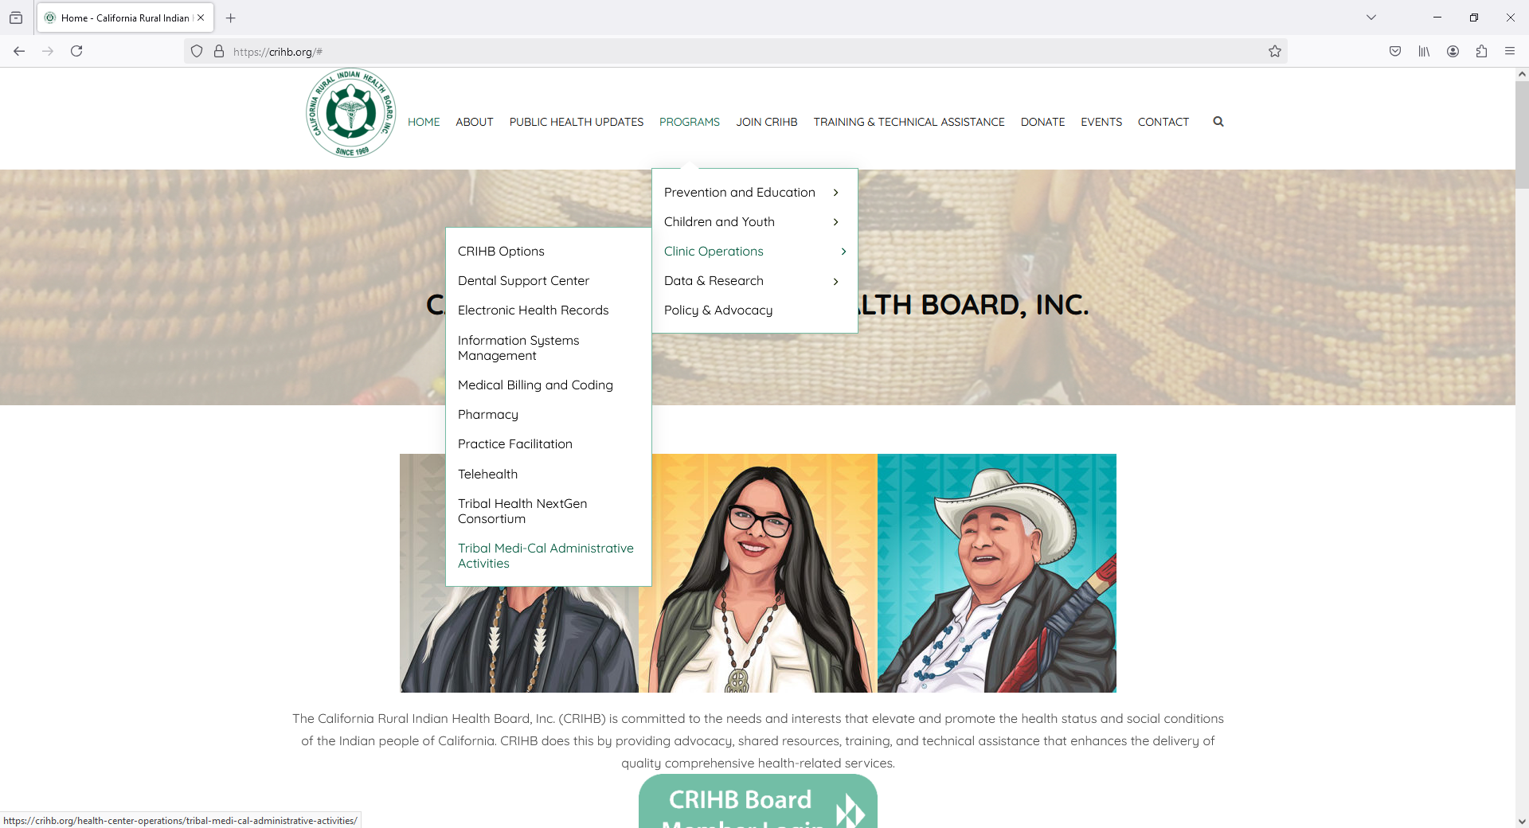
CRIHB.org
1
2
3
www.crihb.org
Notes:
On the CRIHB website located at www.crihb.org you can find information and tools to assist with the TMAA program
Select the program tab
Then select the Clinic Operation stab
Then select the Tribal Medi-cal Administrative tab
* Pull up website and show

Slide 31
Any Questions?

Slide 32
For More Information, Contact:
Koe-Soes Vigil, BS
TMAA Coordinator (Quarterly invoicing/claims)
California Rural Indian Health Board, Inc.
(916) 929-9761 ext 1309
kvigil@crihb.org
Sarah Ponnequin, BS
Program Analyst (Training)
California Rural Indian Health Board, Inc.
(916) 929-9761 ext 1301
sponnequin@crihb.org
Elizabeth Zaragoza, MD
Health Systems Development, Director
California Rural Indian Health Board, Inc.
(916) 929-9761
ezaragoza@crihb.org

