Slide 1
CMS Division of Tribal Affairs Update
Centers for Medicare & Medicaid Services
Training for
Indian Health Service
Tribes and Tribal Organizations
Urban Indian Organizations
Notes:
Good morning/afternoon and welcome to today’s event. I’m ____________________ and I work for the Tribal Affairs office at CMS. Thank you for joining us for our training.
Throughout this presentation we will refer to several links with valuable information. Those links are listed in slides at the end of this presentation.

Slide 2
Role of CMS Tribal Affairs
CMS Division of Tribal Affairs (DTA) is located in Baltimore within the Children & Adults Health Programs Group (CAHPG), under the Center for Medicaid & CHIP Services (CMCS).
DTA serves as the point of contact on Indian health issues for the agency and works in collaboration with Native American Contacts (NACs) to provide technical assistance to our Tribal and Federal partners.
Notes:
Our office, the Division of Tribal Affairs – or DTA – is part of CMS. Specifically, we’re part of the Children & Adults Health Programs Group, abbreviated as “CAP”, within the Center for Medicaid and CHIP Services.
A list of DTA staff and Native American Contacts – or NACs – are posted on our website.
Even though we’re located within Medicaid, we still work on all tribal issues that come up at CMS. For example, we work closely with our partners in:
Medicare
Survey and Certification
The Marketplace
Data and Information Technology offices

Slide 3
Native American Contacts (NACs)
Notes:
A few years ago, CMS underwent a reorganization where we had the opportunity to make some changes to build up expertise on Indian health issues within the agency and therefore to better serve our Tribal communities.
Prior to the reorganization, we had 13 NACS assigned to each of the HHS regional offices. Many of the NACs had to balance their tribal work with other agency priorities and assignments.
As part of the reorganization, we took 10 of the 13 NACs who worked on Medicaid Tribal issues about 20% of the time & condensed them to 4 NACs who work on Medicaid Tribal issues full time. More recently, we have 3 NACs.
As a result of these changes, we are maintaining the same level of workload but by consolidating the work – the NACs can dedicate their time and focus on Medicaid tribal issues and provide the technical assistance needed.
We have also organized the assignments of the Medicaid NACs by the IHS Area Office designations instead of by HHS Regional Office designations. __________________
Our other NACs are:
Barbara Prehmus is the Technical Director working with the NACS and covers the Nashville and Bemidji Areas.
Stacey Steiner covers Albuquerque, Oklahoma, Great Plains Areas and Navajo.
Justyna Redlinksi has Alaska, Portland, Billings, California,, Phoenix and Tucson Areas.
Dorsey Sadongei continues to serve the NAC on Medicare and Survey and Certification tribal issues and co-leads the Oklahoma area.
The NACs also cover tribal work in states that do not have tribal health programs or federally recognized tribes, these are shown in the grey shaded states.

Slide 4
Background and History
In 1976, Congress authorized IHS and Tribal hospitals and clinics to receive reimbursement for services provided to Medicare and Medicaid patients.
The authority to bill Medicare and Medicaid is unique to any other federal health program.
VA and DOD do not have this authority.
IHS publishes its reimbursement rates in the Federal Register on an annual basis, often called the All Inclusive Rate (AIR).
Notes:
This slide shows some of the history of Indian health and CMS programs. We want to highlight that the ability for ITUs to bill CMS is unique. This was intended to increase funding streams from Medicare and Medicaid for Indian health care programs and not to offset IHS funding.
The ability to bill CMS has increased reimbursements to the Indian health system to over 1 billion dollars a year. Reimbursements increase as more people enroll in Medicaid and Medicare – bringing more funding into the Indian health system to meet accreditation standards, buy necessary equipment like MRI machines, and recruit additional staff.

Slide 5
Background and History
In addition to Medicaid and Medicare, ITUs also bill the Children’s Health Insurance Program (CHIP) and private insurance, including those purchased on the Health Insurance Marketplace.
CMS reimburses States 100% for services provided to AI/ANs in IHS and Tribally operated facilities, this is commonly referred to as the 100% Federal Medical Assistance Percentage (FMAP).
Notes:
The Children’s Health Insurance Program, Medicare, and the Marketplace programs are all part of CMS. IHS, Tribes, and urban Indian organizations all have the ability to bill these programs and increase their revenues.
Medicaid is a joint Federal/State program. For services provided to American Indians and Alaska Natives, the Federal government provides 100% full funding to States, which we call the Federal Medical Assistance Percentage, or FMAP. But remember, this funding goes directly to the States, not IHS and Tribes.
By Congress allowing the Federal government to provide 100 percent FMAP and fully fund care provided to American Indians and Alaska Natives, it helps fulfill the Federal government responsibility to provide health care to Tribes.

Slide 6
CMS Tribal Consultation
CMS has an agency specific Tribal Consultation Policy that was updated on December 10, 2015.
Many CMS policies and regulations can have a direct impact on Tribes. Tribal consultation is important in addressing the unique needs of AI/ANs and the Indian health system.
CMS holds Tribal consultation sessions through formal face to face meetings, All Tribes Calls, Dear Tribal Leader letters, and comments received through the rulemaking process.
Notes:
Consultation is a critical part of addressing the unique needs of American Indians and Alaska Natives in our Indian health care delivery system and CMS is committed to tribal consultation and working on policy issues impacting tribal communities and Indian health care providers.
We consult through formal face to face meetings, All Tribes Calls, Dear Tribal Leader Letters, and comments we receive through part of the rulemaking process.
CMS is the only Federal agency with Tribal Consultation at the state level. States with Indian Health Care Providers are required to have Tribal Consultation plans in their Medicaid State Plans.
For more information, visit our State-Tribal relations page.

Slide 7
CMS Tribal Technical Advisory Group
CMS supports a Tribal Technical Advisory Group (TTAG), which provides advice and technical expertise on CMS policies, guidelines and programmatic issues.
The CMS TTAG is comprised of representatives from each of the 12 IHS geographic areas and includes representation of national Indian organizations and IHS.
Notes:
The Tribal Technical Advisory Group, or TTAG, provides advice and expertise on tribal issues facing CMS. We do a lot of our TTAG work through subcommittees, such as Policy, Outreach and Education, Data, Long Term Care, Behavioral Health or Strategic Planning.
TTAG consists of 12 representatives from each of the 12 IHS Areas and a representative from each of the following tribal organizations:
The National Indian Health Board (NIHB)
National Congress of American Indians (NCAI)
National Council on Urban Indian Health (NCUIH)
Tribal Self Governance Advisory Committee (TSGAC)
And the Indian Health Service
We want to thank all the TTAG members from the various Areas.

Slide 8
The Role of CMS in Indian Health Care
CMS developed a video that highlights the history of Indian Health Care, CMS Tribal Consultation and the significant impact that CMS programs have in Indian Country.
Notes:
To help explain CMS’s role in Indian Health, we developed a video that highlights the history of Indian Health Care, CMS Tribal Consultation and the significant impact that CMS programs have in Indian Country. Since the time that the video was produced, there are now 574 federally recognized tribes.

Slide 9
Medicaid and CHIP: AI/AN Cost Sharing Protections
AI/ANs have the following Medicaid and CHIP protections:
Do not have to pay premiums or enrollment fees and can enroll at any time.
No cost sharing for AI/ANs enrolled in CHIP.
No cost sharing in Medicaid if the beneficiary has ever used an Indian health care provider, or received services through Purchased/Referred Care .
Notes:
TRANSITION: Now, we’re going to review protections for American Indians and Alaska Natives in Medicaid, the Children’s Health Insurance Program, the Marketplace, and Medicare. Let’s start with Medicaid.
These are some of the special protections for American Indians enrolled in Medicaid. These special protections are often referred to as “ARRA Protections” because they are a result of the American Recovery and Reinvestment Act of 2009.
As you can see here, Indians enrolled in Medicaid or CHIP:
Do not have to pay premiums or enrollment fees.
And, if they have ever received care from an Indian health care provider - or through an ITU referral to a non-Indian provider - they do not have to pay any cost sharing, such as deductibles, co-insurance, or co-pays.

Slide 10
Medicaid: MAGI and Indian Trust Income and Resource Exemptions
Certain types of Indian income and resources are not counted when determining Medicaid or CHIP eligibility:
Per capita payments from a Tribe that come from natural resources, usage rights, leases, or royalties.
Payments from natural resources, farming, ranching, fishing, leases, or profits from Indian trust land (including reservations and former reservations).
Money from selling things that have Tribal cultural significance, such as Indian jewelry or beadwork.
Notes:
Income determinations for Medicaid and CHIP are different from the Marketplace. In Medicaid and CHIP, certain types of Indian income and resources are not counted when determining eligibility. This slide lists the type of income that is NOT counted in Medicaid.
Payment received from the tribe or individual payments from natural resources, farming, fishing, ranching, rents or other monies from lands designated as Indian land by the Department of Interior are not counted when determining Medicaid eligibility.
This includes land within the boundaries, or the most recent former boundaries of a reservation, and monies for cultural or traditional activities or items. Again, none of these monies are counted for Medicaid or CHIP.
There is one exception: any Indian income derived from gaming DOES COUNT when determining Medicaid income eligibility.
Keep in mind, that the rules for determining income eligibility are different in Medicaid and CHIP than they are for the Marketplace.
For example, if you report income from traditional jewelry you sell when you file your tax returns, then you must report it when determining income eligibility for the Marketplace.
However, if that jewelry has cultural significance, you do not have to report the income from the sale of that jewelry for Medicaid purposes.
The Division of Tribal Affairs has a great fact sheet on our website that explains all the income exclusions in detail. It is called “MAGI and Indian Trust Income.”

Slide 11
Marketplace and Tribal Members
Income that is subject to federal income tax is counted for the Marketplace.
Special Enrollment Period (SEP): Tribal members can enroll in the Marketplace at any time during the year in a Zero or Limited Cost Sharing Plan.
If one family member on the application is eligible for the SEP, all family members who apply on the same Marketplace application are eligible.
This is true even if different family members are eligible for different Marketplace plans as long as they use the same application.
Notes:
Let’s move on to the Marketplace.
Income eligibility is one of the most important special protections for Indian eligibility. It’s important to remember that income eligibility is different on the Marketplace than it is in Medicaid and CHIP.
For the Marketplace, the general rule is if you report something on your income tax return, you report it for Marketplace purposes.
We have a brochure called Understanding Cost Sharing Protections that explains the cost sharing protections on the Marketplace in more detail. You can find that fact sheet on our website.
Keep in mind that Tribal members are responsible for their share of the premiums, after application of Advanced Premium Tax Credits.

Slide 12
Marketplace: Zero Cost Sharing Plans
Zero Cost Sharing Plans:
For AI/ANs with incomes between 100-300% FPL
You do not need a referral for services received outside the Indian health system to avoid cost sharing, co-insurance or deductibles
Notes:
There are two Marketplace plans for Indians:
The first is Zero Cost Sharing Plans. You may qualify for this plan if your income is between 100 and 300 percent of the Federal Poverty Level.
For example, 100 percent of the Federal Poverty Level for a family of four is about $26,000 (twenty six thousand dollars) and 300 percent of the Federal Poverty Level for a family of four is about $78,000 (seventy eight thousand dollars). Keep in mind that the Federal Poverty Level changes every year and you should check online for the exact amount.
In Zero Cost Sharing Plans, you do not need a referral for services received outside the Indian health system to avoid cost sharing, like co-pays, co-insurance, or deductibles.

Slide 13
Marketplace: Limited Cost Sharing Plans
Limited Cost Sharing Plans:
For AI/ANs with incomes less than 100% and more than 300% FPL
You do need a referral for services received outside the Indian health system to avoid cost sharing, co-insurance or deductibles
Notes:
The second plan is called a Limited Cost Sharing Plan.
You may qualify for Limited Cost Sharing if your income is less than 100 percent or more than 300 percent of the Federal Poverty Level. And again, 100 percent of the Federal Poverty Level for a family of four is about $26,000 (twenty six thousand dollars) and 300 percent of the Federal Poverty Level for a family of four is about $78,000 (seventy eight thousand dollars).
It’s important to remember that, in Limited Cost Sharing, you do need a referral for services received outside the Indian health system to avoid cost sharing.
Please visit our outreach and education page to learn more about the Marketplace and American Indians and Alaska Natives.

Slide 14
Medicare Enrollment and Disenrollment
Medicare Annual Enrollment Period (AEP) is October 15 through December 7th - often referred to as Medicare Open Enrollment.
During the AEP, Medicare beneficiaries may enroll or disenroll from a Medicare Part C (Medicare managed care plan or otherwise known as Medicare Advantage (MA).
MA plan enrollees may enroll in another MA plan, or disenroll and return to Original Medicare.
Medicare Advantage Open Enrollment Period (MA OEP) is January 1 – March 31.
During the MA OEP, individuals already enrolled in a MA plan, can add or drop Part D (prescription drug) coverage and individuals enrolled in a MA-Part D plan or MA-only plan, can switch to a: MA Part D plan, an MA-only plan or to Original Medicare (with or without a Part D plan).
The effective date for an MA -OEP election is the first of the month following receipt of the enrollment request. For instance, if an individual who enrolled in a MA-only plan during AEP, and now wants to enroll in Original Medicare, they can use the MA-OEP to do this. If they make this request on January 10th, it will be effective February 1st.
Notes:
The next few slides cover Medicare issues.
The Medicare Annual Enrollment Period, what we refer to as the AEP, is October 15 through December 7th - often referred to as Medicare Open Enrollment. During Medicare Open Enrollment, Medicare beneficiaries may enroll or disenroll from Medicare Part C, which includes Medicare managed care plans and are otherwise known as Medicare Advantage, or MA, plans.
The special open enrollment for MA Plans runs from January 1 through March 31. During the MA open enrollment, individuals already enrolled in a MA plan, can add or drop their Part D coverage and individuals enrolled in a MA-Part D plan or MA-only plan, can switch to one of the following: a MA Part D plan, an MA-only plan or to Original Medicare.
The effective date for a plan selected during MA open enrollment is the first of the month following receipt of the enrollment request.
For instance, if someone enrolls in a MA-only plan during Medicare open enrollment but now wants to enroll in Original Medicare, they can use the MA open enrollment to do this. If they make this request on January 10th, it will be effective February 1st.

Slide 15
Medicare Part C Enrollment and Disenrollment
Special Enrollment Period for Exceptional Circumstances:
For those who think they were misled in enrolling in a MA plan or don’t know how they became enrolled into a MA plan, there is a Special Enrollment Period (SEP), on a case by case basis, for individuals whom CMS determines has experienced exceptional circumstances.
Individuals should contact 1-800-Medicare and file a complaint or request a SEP.
Notes:
For those who think they were misled in enrolling in a MA plan or don’t know how they became enrolled into a MA plan, there is a Special Enrollment Period, or SEP, on a case by case basis, for those that have experienced exceptional circumstances. Individuals should contact 1-800-Medicare to file a complaint or request an SEP.
CMS will consider granting an enrollment or disenrollment opportunity in certain situations such as the following:
First, circumstances beyond the beneficiary’s control that prevented them from submitting a timely request to enroll or disenroll from a plan during a valid election period. This includes situations like a serious medical emergency, a change in hospice status, or mailed enrollment or disenrollment requests that were returned as undeliverable on or after the last day of an enrollment period.
The second situation could be if a beneficiary provides a verbal or written allegation that his or her enrollment in a MA or Part D plan was based upon misleading or incorrect information provided by a plan representative or State Health Insurance Program (SHIP) counselor, including situations where a beneficiary states that they were enrolled into a plan without their knowledge or consent, and requests cancellation of the enrollment or disenrollment from the plan.
A special enrollment period may be warranted to ensure beneficiary access to services and where without the approval of an enrollment exception, there could be adverse health consequences for the beneficiary. This includes situations like maintaining continuity of care for a chronic condition and preventing an interruption in treatment.

Slide 16
Additional Updates
Medicaid Redeterminations Reminders
1115 demonstration proposals for Medicaid coverage of Traditional health care practices
Medicaid managed care toolkit

Slide 17
Medicaid Redeterminations
UPDATE your contact information with your state Medicaid or CHIP Agency.
RESPOND to the Medicaid/CHIP renewal form when it arrives to keep your coverage.
PARENTS should respond even if you don't think you're eligible – your kids could still be eligible.
CONSIDER OTHER COVERAGE OPTIONS: If you are no longer eligible for Medicaid or CHIP, check if you can get coverage through your employer, through the Affordable Care Act Marketplace at HealthCare.gov, or through Medicare.
www.Medicaid.gov/unwinding

Slide 18
Traditional Healthcare Practices
There are four approved 1115 demonstrations for Medicaid coverage of traditional healthcare practices: AZ, CA, OR and NM.
Eligible Beneficiaries: Any Medicaid beneficiary eligible to receive services at an IHS or Tribal facility.
Traditional health care practices: Practices that are delivered by IHS or Tribal facilities.
Providers/Practitioners: Employed or contracted by IHS or Tribal facilities.
Notes:
AZ is considered to be used as a template for state Medicaid offices to use as TH best practice demonstration.

Slide 19
Medicaid and CHIP Managed Care Oversight Toolkits
On October 30, 2023, CMS released the Tribal Protections in Medicaid and CHIP Managed Care Oversight Toolkit.
The Toolkit builds on recommendations from a National Indian Health Board Managed Care Roundtable Report released in August 2022. https://www.nihb.org/docs/phrc-uploads/08152022/medicaid-managed-care-report_final_08102022.pdf
The Toolkit provides resources for states, managed care plans, and IHCPs to use to maximize the benefits of Medicaid and CHIP managed care for AI/AN enrollees and the IHCPs.

Slide 20
Fact Sheets and Brochures
Brochures with information about coverage and Indian health facilities in your State.
Notes:
TRANSITION: Now let’s move on to discussing our outreach and education materials.
The Division of Tribal Affairs develops lots of fact sheets and brochures. These are examples of our latest series of brochures, which have information about coverage and Indian health facilities in your state.
Several years ago we held focus groups to test materials and found that utilizing graphics and pictures of tribal beneficiaries or communities increased the likelihood of the material being picked up and used.
Our materials are developed to be culturally appropriate and utilized in tribal communities.
If you find any errors in our materials, please let us know by emailing us at tribalaffairs@cms.hhs.gov.
All of our materials are available for download on our website or to order from our warehouse. We’ll go over how to order materials later on in the presentation.

Slide 21
AI/AN Specific Training Materials
Notes:
Our brochures and fact sheets cover topics like:
MAGI and Indian Trust Income and Marketplace Protections for AI/ANs, which I mentioned earlier
We also have fact sheets on Medicare, Medicaid, and other CMS programs.
We also update existing CMS materials to make them tribal specific to our communities, such as our Tribal Glossary and the Tribal Coverage to Care brochure.
We also developed a dozen one page fact sheets due to feedback that a more simple message and information with an activity on the back page would be perfect for waiting rooms. Some of the fact sheets have a coloring page or a game on the back.
See the DTA outreach and education webpage for more training materials.

Slide 22
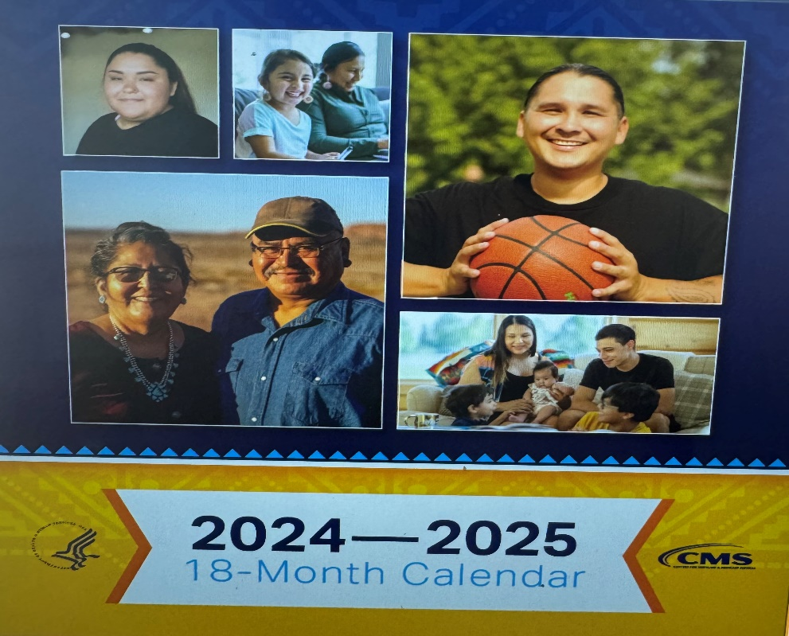
Tribal Calendar
Notes:
We work with our contractor to develop the 18 month calendar each cycle.
This calendar features health information, website links, and other helpful tips to improve your overall health.
The information in the calendar is intended to assist tribal families in taking better control of their health, including enrollment in health coverage through Medicare, Medicaid, CHIP, and the Health Insurance Marketplace.
The calendar is available to order through our website.

Slide 23
Monthly drop-in “news ads” and Radio Clips
30 second radio clips using the same topic selected for drop-in “news shorts.”
Recorded in ten Native languages:
Dine, Lakota, Ojibwe
Yupik, Zuni, Cherokee, Salish, Tohono O’odham, Tlingit, and Inupiaq
August 2023
Available on YouTube
Notes:
DTA also produces monthly Public Service Announcements.
We use two platforms for our monthly messages: newspaper and radio ads. We air on the radio because during the focus group testing, we found that radio was still an effective means of reaching our tribal populations.
We received feedback that it would be effective to also have these PSAs in some our own languages so we started recording them in native languages too.
Our PSAs are translated into TEN tribal languages:
Dine (“duh-nay”) (Navajo), Lakota (Sioux), Ojibwe (Chippewa), Yupik, Zuni, Cherokee, Salish, Tohono O’odham, Tlingit and Inupiaq.
We also have an English version with local speakers from those areas that are aired along with the traditional language PSAs.
We are aware that there are many other languages that are spoken in your communities but we only have enough funding to translate in these ten languages. But, if you would like to translate them for your local use, please contact us.
Monthly drop-in ‘news ads” are published in
Radio clips air on these stations:
Indian Country Today
KTNN – Navajo – Window Rock, AZ
Navajo Times
KILI – Lakota - Pine Ridge SD
Cherokee Phoenix
KEYA – Chippewa – Belcourt, ND
The Seminole Tribune
KSHI – Zuni – Pueblo of Zuni, Zuni, NM
Juneau Empire
KYUK – Yupik – Bethel, Alaska
Indian Country Today
KEOK – Cherokee – Tahlequah, OK
Alaska Dispatch News
KCPN – Chickasaw – Ada, OK
Lakota Times
KHON – Tohono O’odham – Sells, AZ
News From Indian Country
KYKT – Tlingit – Yakautat, Alaska
The Ada News
KBRW – Inupiaq – Barrow, Alalska
The Arctic Sounder
Koahnic Broadcast Corporation – all six languages
The Runner (Covering the Tohono O’odham Nation)
Native Voice One – all six languages
Alaska Dispatch News

Slide 24
Customizable Flyers
Mom Kissing Girl
Man
Mom and Baby
Boy on Bike
Subject: Medicaid Enrollment Fact Sheet Customization Request
Email tribalaffairs@cms.hhs.gov to order
Notes:
We heard from many of you that you would like to customize a fact sheet with your own information. So we developed four versions of a Medicaid and CHIP flyer that you can request to be customized for your location.
You can see on the slide that the four versions are:
Mom Kissing Daughter, Man, Mom and Baby, and Boy on Bike.
The message is the same for all of the fact sheets: Enroll in Medicaid for yourself, for your family, for your community.
These fact sheets can be used in outreach and enrollment activities to help families and individuals understand basic information about Medicaid and CHIP.
They describe who may be eligible for Medicaid and CHIP, the health coverage benefits the programs provide, and how to apply.
The fact sheets also cover specific protections for American Indian and Alaska Native beneficiaries, and highlight the advantages of enrollment for families and for the community.
Indian health care providers can choose to insert their:
Program name
Website address
Phone number
And up to two logos.
You can request a customized flyer from our office but keep in mind that it will take up to five weeks to send you a customized flyer that you are able to print. Please send your request to tribalaffairs@cms.hhs.gov with the Subject: Medicaid Enrollment Fact Sheet Customization Request

Slide 25
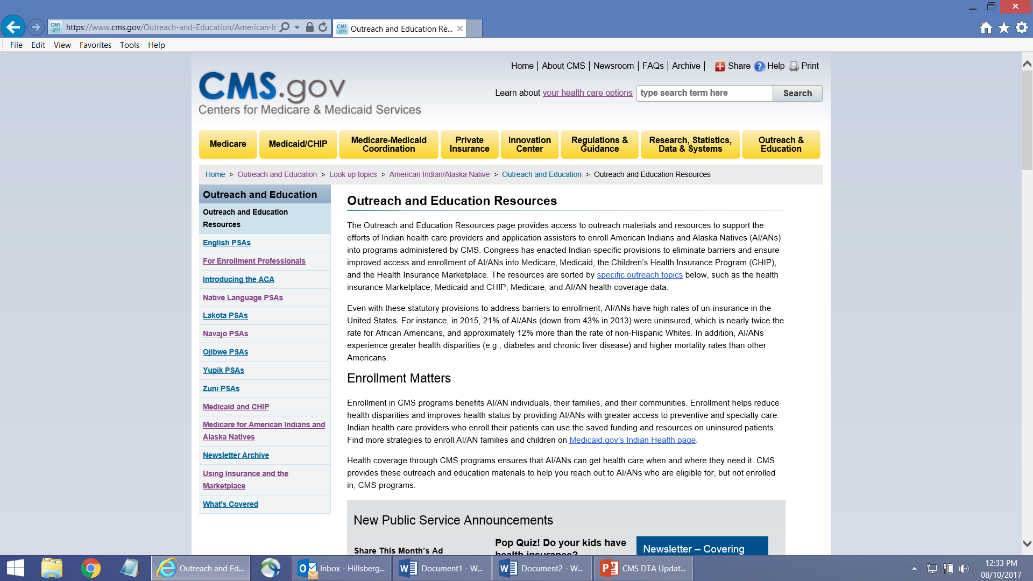
CMS AI/AN Website go.cms.gov/AIAN
Notes:
The CMS Division of Tribal Affairs has a great website. You can find it easily at go.cms.gov/AIAN.
This is also where you will find the link to our You Tube videos and public service announcements, under the Outreach and Educations Resources tab.

Slide 26
Long Term Services & Supports Newsletter
CLICK HERE
Notes:
Tribal Affairs has two monthly newsletters you can sign up to receive in your email.
The first is for Long Term Services and Supports
The second focuses on CMS Outreach and Education activities.
This slide shows the webpage where you can sign up for the LTSS newsletter. You can see there is a link where you can click to sign up.

Slide 27
Outreach and Education Newsletter
CLICK HERE
Notes:
You can sign up for the Outreach and Education newsletter by going to the Outreach and Education section of our website.
Scroll down to “New Public Service Announcements”, then click on the “Sign up” button.

Slide 28
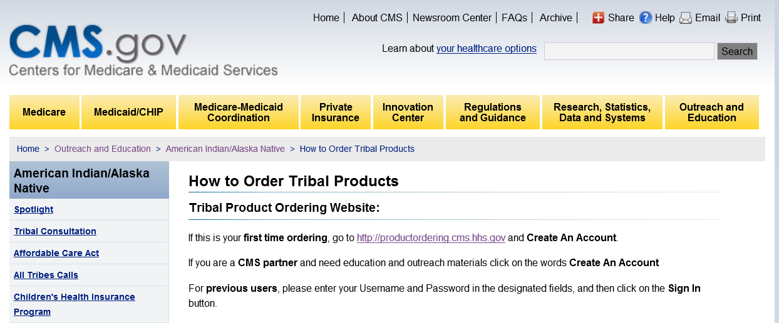
How to Order Tribal Products
If this is your first time ordering, visit: http://productordering.cms.hhs.gov
Notes:
I’ve mentioned several times that you can order materials from CMS. The materials are free and you can order as much as you want as often as you want.
To get started, go to our products ordering page to create an account. Then, log on and order materials. You can do a search for tribal specific material and see a thumbnail of the product before you order it.
Please allow two weeks for your materials to arrive. You can also download materials from our website at go.cms.gov/AIAN

Slide 29
CMS ITU Trainings and Webinars
CMS provides face-to-face trainings
CMS is now holding some trainings in-person and some virtually.
To register or see a complete list of trainings visit www.regionalcmsitutrainings.com
CMS provides two (2) week medical coding boot camps.
CMS holds webinars throughout the year
Notes:
Due to the public health emergency, face-to-face trainings were held virtually over the past couple of years. CMS is in the process of beginning holding some of the ITU trainings in person.
CMS will also be holding medical coding boot camps. These trainings are for the IHS, tribal, and urban coding staff. It is an intensive two week training that prepares staff to test at the end of the training for their AAPC certification. The participants will register with their “H-I-M” consultants in each area. These trainings are limited to 25 students per session.
Please check with your H-I-M for information on when these trainings will be happening.
CMS also holds webinars on various topics, please check our Spotlight page on our website for any upcoming events.

Slide 30
Links: Resources
Link to DTA-NAC sheet: https://www.cms.gov/files/document/cms-native-american-contact.pdf
Link to Indian Health 101 Video: https://www.youtube.com/watch?v=I2EnR88gIZM
Notes:
The following slides have all the links that I’ve referenced throughout this presentation. I won’t spend time going through these now but you will have them if you want to refer to them later.

Slide 31
Links: Fact Sheets and Brochures
Link to AI/AN Trust Income and MAGI Fact Sheet: https://www.cms.gov/Outreach-and-Education/American-Indian-Alaska-Native/AIAN/Downloads/AIAN-Trust-Income-and-MAGI.pdf
Cost Sharing Protections Brochure: https://www.cms.gov/Outreach-and-Education/American-Indian-Alaska-Native/AIAN/Downloads/Understanding-Cost-Sharing-brochure.pdf

Slide 32
Links: Websites and Webpages
CMS Tribal Affairs page: go.cms.gov/AIAN
State Tribal Relations page: https://www.cms.gov/Outreach-and-Education/American-Indian-Alaska-Native/AIAN/State-Tribal-Relations-on-Health-Care

Slide 33
Links: Websites and Webpages
Link to DTA Outreach and Education page, Newsletter, and PSAs: http://go.cms.gov/AIAN-OutreachEducationResources
Link to LTSS Newsletter: https://www.cms.gov/Outreach-and-Education/American-Indian-Alaska-Native/AIAN/LTSS-TA-Center/ltss-newsletter

Slide 34
Links: Websites and Webpages
Link to Products Ordering page: http://productordering.cms.hhs.gov
Link to Training website: www.regionalcmsitutrainings.com
Link to Archived Outreach and Education Webinars: http://go.cms.gov/All-Tribes-Calls

Slide 35
CMS Division of Tribal Affairs
For additional information:
DTA Website: go.cms.gov/AIAN
Questions: tribalaffairs@cms.hhs.gov
Notes:
Thanks for joining us today.

