Slide 1
COVERED CALIFORNIA 101 FOR AMERICAN INDIANS/ALASKA NATIVES Waynee Lucero, Tribal Liaison, Deputy Director External Affairs and Community Engagement Division

Slide 2
Agenda
Affordable Care Act
What is Covered California
Benefits available for American Indians/Alaska Natives through Affordable Care Act/Covered CA
Questions & Answers

Slide 3
AFFORDABLE CARE ACT (ACA)
The Patient Protection and Affordable Care Act (ACA) is a comprehensive reform law, enacted in 2010, that increases health insurance coverage for the uninsured and implements reforms to the health insurance market.
A State-Based Marketplace (SBM) is a government agency offering subsidized ACA plans for the state, like Healthcare.gov but created and maintained by the individual state.
Insurance Market Reforms: Guaranteed issue and renewal; no annual or lifetime limits; coverage for essential health benefits; dependent coverage up to age 26
Medicaid Expansion: Inclusion of low-income childless adults.

Slide 4
Marketplace Benefits and coverage levels
The Affordable Care Act (ACA) requires that products sold in the individual market cover 10 essential health benefit categories*.
Laboratory Services
Emergency Services
Prescription Drugs
Mental Health & Substance Abuse Disorder
Preventive & Wellness Services
Pediatric Services
Rehabilitative Services
Ambulatory Patient Services
Maternity & Newborn care
Hospitalization
*Copays and deductibles may apply to these services
Notes:
The Affordable Care Act requires that products sold in the individual market cover the 10 essential health benefits.
Laboratory services.
Emergency services (e.g., ambulance, first aid, and rescue squad).
Prescription drugs.
Mental health and substance use disorder services, including behavioral health treatment.
Preventive and wellness services and chronic disease management (e.g., blood pressure screening, immunizations).
Pediatric services, including dental and vision care.
Rehabilitative and habilitative services and devices (e.g., therapy sessions, wheelchairs, oxygen.
Ambulatory patient services (e.g., doctor and clinic visits).
Maternity and newborn care.
Hospitalization.

Slide 5
Marketplace Benefits and coverage levels
The ACA defines four “metal tiers” of coverage for these benefits that vary by Actuarial Value (AV), which is the percentage of the total average costs that a health insurance plan will pay for covered benefits throughout the year.
The four metal tiers, from the plan that requires the most out-of-pocket expenses to the least, are Bronze, Silver, Gold, and Platinum.
The tiers are not related to the quality of medical care, and all plans cover the same essential benefits.
Plans with a lower AV have lower monthly premiums but higher cost-sharing.
Notes:
For all these essential health benefits, the ACA defines 4 metal tiers of coverage. These metal tiers offer the same quality of care however vary when it comes to costs. In each of these metal tiers, costs are defined by the actuarial value or the AV which is the average portion of the total healthcare costs that are covered by the health insurance carrier versus the portion that the consumer will pay out of pocket, throughout the year. For the four metal tiers that we offer, the AV varies between 60-90% and these tiers are Bronze, silver, gold and Platinum.
And so plans with the lower AV will have lower monthly premiums. But when they go to the doctor, they'll have higher cost sharing or copays or coinsurance.

Slide 6
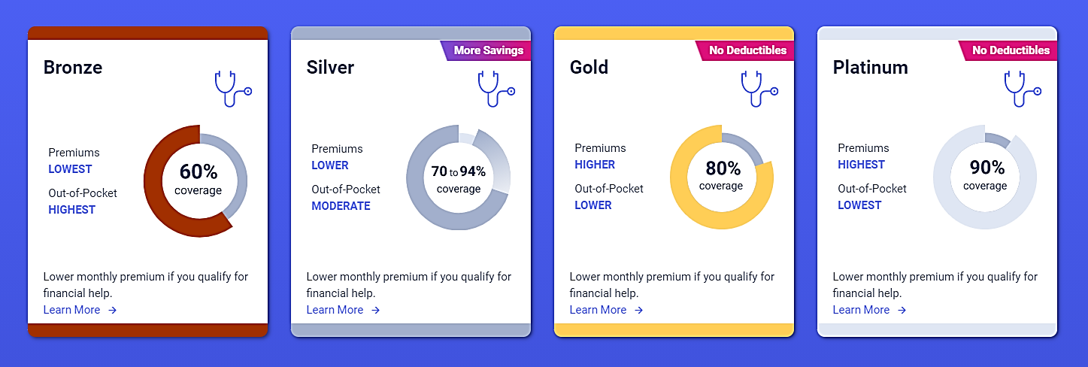
Health plan coverage level: metal tiers
A plan with a lower premium results in a larger copayment with higher deductibles and maximum out-of-pocket expense.
Minimum coverage plans are also available to people who meet certain requirements, although these plans are not eligible for financial help.
Notes:
In the general individual market, we have products that are bronze, silver, gold and platinum. So, if an individual chooses a platinum plan, they have higher monthly premiums that they must pay to the carrier each month. However, when they go to the doctor, they have lower out of pocket costs versus a bronze plan where the monthly premiums are lower, but when they go to the doctor, they'll be spending a lot more on those out-of-pocket costs.
Now we will come back to this slide later on in the presentation because depending on your income, if you're American Indian and Alaska native it changes slightly. Usually in the individual marketplace we don’t encourage non-AIAN folks to pick a bronze plan because of those high out of pocket costs, but that changes a little bit for American Indian and Alaska natives.
All plans, regardless of state, will fall into one of five levels of coverage: Bronze, Silver, Gold, Platinum, or Catastrophic. Each of these levels is defined by the actuarial value of the plan, which is as follows:
Bronze: Plan pays 60%
Silver: Plan pays 70%
Gold: Plan pays 80%
Platinum: Plan pays 90%
Coverage Levels/Metal Tiers Fact Sheet Covered California health insurance plans are sold in four primary levels of coverage called “Metal Tiers”: Bronze, Silver, Gold and Platinum. As the metal category increases in value, so does the percentage of medical expenses that a health insurance plan covers and pays for, compared with what you are expected to pay in copays and deductibles. Plans in the higher metal tiers have higher monthly premiums, but you pay less when you need medical care. If you choose to pay a lower monthly premium, then you will pay more when you need medical care. You can choose the level of coverage that best meets your health needs and budget. The breakdown of costs that you pay (dark shading) and costs the plan pays (lighter shading) for the standard Bronze, Silver, Gold and Platinum tiers is shown below.
Bronze: On average, your health plan pays 60 percent of your medical expenses, and you pay 40 percent. • Silver: On average, your health plan pays 70 percent of your medical expenses, and you pay 30 percent. In some cases, individuals may qualify for an Enhanced Silver plan. This means that when they choose a Silver plan, they have – based on their income – enhanced out-of-pocket savings through lower copays, coinsurance and deductibles. Individuals in these savings categories get the benefits of a Gold or Platinum plan for the price of a Silver plan. In the three categories of Enhanced Silver, the plan pays either 94 percent, 87 percent or 73 percent of expenses, with the enrollee responsible for the rest.
Gold: On average, your health plan pays 80 percent of your medical expenses, and you pay 20 percent. • Platinum: On average, your health plan pays 90 percent of your medical expenses, and you pay 10 percent. In addition to the metal tiers, Covered California offers a minimum coverage plan for those who qualify. • Minimum coverage plan: If you’re under 30, you may be able to buy an additional health insurance plan option called minimum coverage plan. These plans usually have lower premiums and mostly protect you from worst-case scenarios.
Minimum coverage plans through Covered California cover three doctor visits or urgent care visits, including outpatient mental health/substance use visits, with no out-of-pocket costs, and free preventive benefits. All other services will be full price but at the negotiated in-network price, until you spend $6,850, after which all in-network services are covered at 100 percent.

Slide 7
Affordable Care Act (ACA) Provisions for American Indians
AI/AN consumers have special benefits and protections in the Health Insurance Marketplace
Special monthly enrollment status
Zero cost sharing plan option for household incomes between 100% and 300% of the Federal Poverty Level
Limited cost sharing plan option for household incomes below 100% or above 300% of the Federal Poverty Level
No copays, deductibles, coinsurance for zero and limited cost sharing plans when receiving care from Indian health care providers or with a referral
A list of federally recognized tribes is available at BIA Tribal Leaders Directory, and a list of village or regional corporations formed under ANCSA is available at Index of Regional Native Corporations.
Notes:
The Marketplace provides certain protections for AI/ANs: Special Enrollment Periods (SEPs): Members of federally recognized tribes can enroll in the Health Insurance Marketplace throughout the year, not just during the annual Open Enrollment period (OEP). Members may also change plans as often as once a month.
Zero cost sharing plan: Members of federally recognized tribes with income between 100 percent and 300 percent of the federal poverty level (FPL) can enroll in a zero-cost sharing plan, which means these consumers won’t have to pay any out-of-pocket costs such as copays, deductibles, or coinsurance when receiving care from Indian health care providers or when receiving essential health benefits (EHB) through a QHP.
Limited cost sharing plan : Members of federally recognized tribes with income below 100 percent and above 300 percent of the FPL can enroll in a limited cost sharing plan, which means no copays, deductibles, or coinsurance when receiving care from Indian health care providers.
A referral from an Indian health care provider to a QHP is required when receiving EHB through the QHP to avoid copays, deductibles, or coinsurance.
These consumers can enroll in a limited cost sharing plan at any metal level.
Members of federally recognized tribes are not exempt from QHP premiums. However, they may qualify for APTCs to lower their premiums based on their income.

Slide 8
WHAT IS COVERED CALIFORNIA?
Notes:
So, what is covered CA?

Slide 9
WHAT IS COVERED CALIFORNIA?
Covered California is the State-Based Marketplace under the Affordable Care Act where Californians can shop for health plans and access financial assistance, if they qualify for it.
The only place where eligible Californians can receive federally-funded financial assistance to help pay for healthcare premiums.
Financial assistance includes tax credits paid in advance to the health plans — also known as Advanced Premium Tax Credits (APTC) and cost-sharing reductions.
More about Advanced Premium Tax Credits: https://www.coveredca.com/pdfs/Welcome-APTC-insert.pdf
Notes:
Covered California is California’s State based marketplace established under the Affordable Care Act. This is where Californians can come and shop for health insurance plans and access financial assistance if they qualify for it. It's the only place where eligible Californians can receive federal financial assistance to help pay for healthcare premiums, which is the monthly cost for your healthcare plan. Financial assistance is in the form of tax credits paid in advance to the health plans, these are also known as advanced premium tax credits or APTC.
Based on your income, you may also be eligible for cost- sharing reductions which means that you pay less out of pocket each time you get medical services. The lower your income within the range, the more you'll save. The zero cost sharing and the limited cost sharing plans that we mentioned earlier are an example of that which we look at in a bit.

Slide 10
COVERED California AND MEDI-CAL
Medi-Cal is a separate state program, managed by the Department of Health Care Services (DHCS) that offers low-cost or free health coverage to eligible Californian residents with limited income.
Health plans available through Medi-Cal and Covered California both offer a similar set of important benefits, called Essential Health Benefits (EHBs).
Most consumers with incomes at or below 138 percent or below of the Federal Poverty Level (FPL) may be eligible for Medi-Cal coverage.
Covered California and DHCS have partnered to create a Single Streamlined Application to apply for health coverage. Depending on income, consumers will be either eligible for Covered California and if they are Medi-Cal eligible, their information is sent to their county.
Notes:
Medi-Cal is a separate state program. It's managed by the Department of Health Care Services and it offers low-cost and free health coverage to eligible Californians with limited income.
Health plans that are available through both medi-cal and covered California offer the same essential health benefits that I mentioned earlier, and you can apply for both programs at the same time when you use the single streamlined application on our website. Consumers can go through the application and then depending on their income, they will be sent either to their County if they're eligible for medi-cal or they would continue the online process of enrolling into a Covered California plan. Most of the times, individuals that are below 138% of the federal poverty level would be eligible for medi-cal. We will also look at the FPL chart later on since it provides more details on income levels and eligibility.

Slide 11
Covered California Eligibility
Applicant Eligibility Criteria for Covered California
Be a California resident or person who intends to reside in California
Be a U.S. citizen or national, or lawfully present in the U.S
Not be incarcerated
Notes:
Eligibility is dependent on income and some additional factors like

Slide 12
FINANCIAL ASSISTANCE ELIGIBILITY REQUIREMENTS
Factors that determine eligibility for financial assistance and the amount:
Household income,
Household size,
Age of household members, and
Location of the household (which determines the pricing region)
Not enrolled in Minimum Essential Coverage (MEC) or have MEC made available to them.
Note - this does not apply to tribal members receiving care from a Tribal Health Program
Members who receive federal financial assistance (APTC) must file their federal taxes to reconcile the APTC amount with the IRS.
Notes:
There are various factors that then determine your eligibility for the tax credits that I mentioned earlier These include your household income, the size of your household, the age of the members in your household, where you're located in the state of California, and it’s also important to know if you already have an offer of minimum essential coverage (like from a job-based plan, medi-care, medi-cal).
However, a lot of this does not apply to any tribal members that are receiving care through a tribal health provider. So, they can continue going to their tribal health program to receive services and care, and that will not impact their eligibility for Covered California.

Slide 13
2025 Covered California Health plan companies
Covered California provides quality health coverage from private health insurance companies.
These 12 companies meet all the state and federal requirements for health plans, plus additional contractual requirements set by Covered California.
Health companies offer one or more of these products: PPO, HMO, and/or EPO; and a wide variety of doctors and hospitals.
Notes:
Now that we have a better understanding of what CCA is and the eligibility criteria for enrolling, Let’s see what are some of the offerings that we have for our current and prospective consumers.
Covered California negotiates with many private health insurance companies, and we are considered an active purchaser. We negotiate to try to keep the prices low but the quality of services high and for 2025, we will have 12 companies that will be offering coverage through Covered California. These companies offer a wide variety of doctors and hospitals, and they must meet state and federal requirements for health plans. Plus, we put additional standards on these plans to hold them accountable. Most recently, we introduced additional quality standards in our contract to make sure that our plans are meeting the minimal base of quality for individuals that are enrolled in their plans. The products that are offered in these plans vary from PPOs, HMOs and or EPOs.

Slide 14
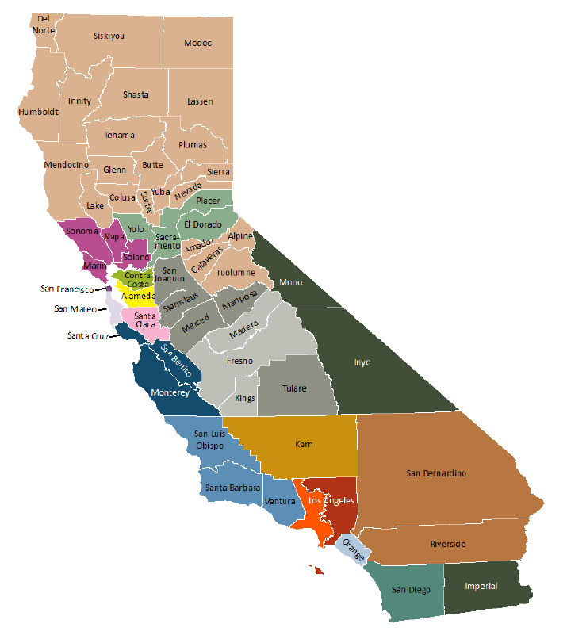
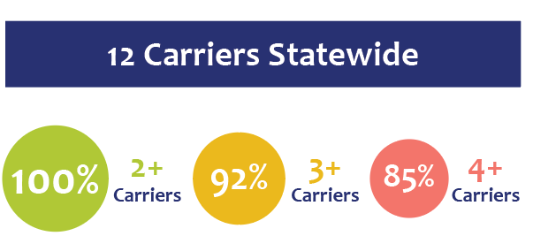
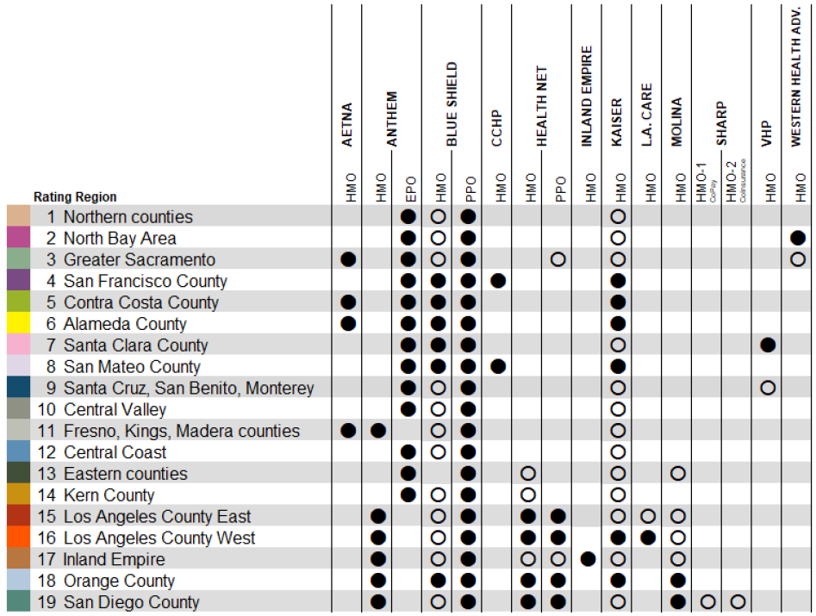
2025 Covered California health plan offerings
RATING REGIONS
Notes:
These offerings are divided across 19 rating regions, and the specific plans and products available vary depending on the rating region you reside in. For PY 2025, All Californians will have a choice of two or more carriers. 92% of Californians have a choice of three or more.

Slide 15
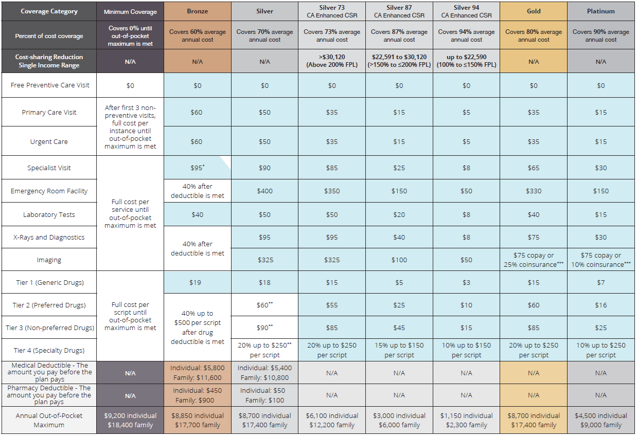
2025 Health Benefit design by metal tier
Benefits in blue are NOT subject to a deductible. Benefits in blue with a white corner are subject to a deductible after the first three visits.
Drug prices are for a 30-day supply. * Copay is for any combination of services (primary care, specialist, urgent care) for the first three visits. After three visits, future visits will be at full cost until the medical deductible is met. ** Price is after pharmacy deductible amount is met. *** See plan Evidence of Coverage for imaging cost share.
Notes:
Covered California is also unique because we have what we call standard benefit designs. These are apples to apples comparisons for individuals to be able to look and see what potential costs they are going to have when it comes to their health insurance. And no matter what plan and which company they choose, they have visibility into the copays, deductibles and other out of pocket costs that they're going to have. In addition to these, the ACA requires that the health plans also provide Provide a standardized Summary of Benefits and Coverage (SBC) so consumers can easily understand their coverage and compare it to other available options. So really the individual can choose their coverage level based on the metal tier system of the bronze, silver, gold or platinum. For example, a primary care visit may cost $60 in a bronze plan, but $35 on a gold plan. Having these costs broken out, makes the choices a lot more clear and individuals are able to know what to expect from their health care plan and the cost of seeking and availing services.

Slide 16
2025 FAMILY DENTAL AND VISION COMPANIES
All health plans include dental care for children at no extra cost.
Adults can purchase a family dental plan when they enroll in a Covered California health insurance plan.
There must be at least one adult (age 19 or older) enrolled in a family dental plan for a child in the family to enroll. (Not all adults in the household are required to enroll.) If a family chooses to enroll children in a family dental plan, all children younger than 19 who live in the household must enroll.
Children under age 19 get free vision care included with their parent’s Covered California health plan.
Adults can enroll directly with one of our three contracted vision companies. All offer excellent benefits.
https://www.coveredca.com/vision/adult/
https://www.coveredca.com/vision/childrens-vision/
https://www.coveredca.com/individuals-and-families/getting-covered/dental-coverage/family/
Notes:
Covered California also offers family dental and vision along with pediatric dental. Children’s dental benefits are automatically included with our health plans. All pediatric dental preventative and diagnostic services are offered at no cost. However, adults can only enroll into a dental plan when they enroll into a health insurance plan, and for dental they have to wait until open enrollment to enroll. For a child in a family to enroll, there must be at least one adult already enrolled in the family dental and its the same with vision. Adults can enroll directly with one of our contracted vision plans and so they can go directly to that vision plan. We do negotiate rates with the dental plans like we do with the health plans. There is therefore an opportunity to secure comprehensive coverage for your entire family through Covered California, which includes healthcare, dental, and vision benefits.

Slide 17
BENEFITS AVAILABLE TO AI/AN THROUGH COVERED CALIFORNIA
Notes:
We will now take a look at some of the available benefits for American Indian and Alaska natives through Covered California

Slide 18
BENEFITS FOR AMERICAN INDIAN/ALASKA NATIVE (AI/AN)
Many AI/AN currently receive health care from Indian health care providers, which include health programs operated by the Indian Health Service (I), Tribes and Tribal organizations (T), and Urban Indian organizations (U). These health programs are sometimes collectively referred to as I/T/Us (IHS/Tribal/Urban).
If AI/AN enroll in a plan through Covered California, they can continue to receive services from their local Indian health care provider. Most I/T/Us do not provide specialty or emergency care but those are covered under the ACA when enrolled in Covered California.
AI/AN can enroll in or switch plans (as often as once a month) in Covered California throughout the year, not just during the annual open enrollment period.
Depending on income, AI/AN can enroll in a zero cost or limited cost sharing plan.
Notes:
As mentioned earlier, AIAN individuals have the advantage of maintaining their healthcare services through Indian health providers, managed by either Indian Health Services, tribes, tribal organizations, and urban Indian organizations. While these may not provide hospitalizations, emergency or specialized care, Covered California plans do encompass these services. This ensures that if hospitalization or a referral for specialized care is required, you have the necessary coverage through a plan within Covered California. And if an American Indian, Alaska native is enrolled in a plan via covered California, they can continue to receive services through the I/T/Us. And as we mentioned earlier, under the ACA AIAN have special enrollment throughout the year and options like zero and limited cost sharing plans.

Slide 19
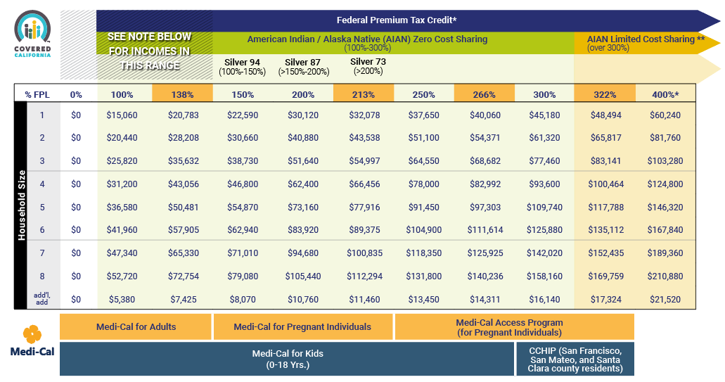
American Indian/Alaskan native Program eligibility
Program Eligibility by Federal Poverty Level for 2025
Your financial help and whether you qualify for various Covered California or Medi-Cal programs depends on your income, based on the Federal Poverty Level (FPL)
Notes:
This is the 2025 FPL chart –
It gives you very clear information in regard to income levels, household sizes and eligibility. We can see that the green demarcates the AIAN incomes that are between 100-300% of the FPL and eligible for a 0 cost share plan and the over 300% in yellow that shows the limited cost sharing plans for AIAN

Slide 20
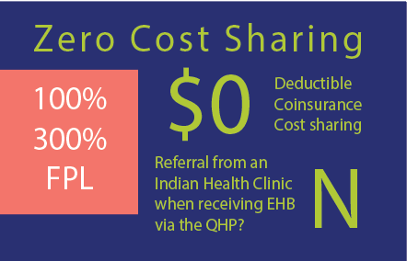
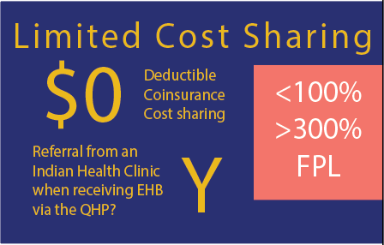
AMERICAN INDIAN/ALASKA NATIVE ZERO-COST AND LIMITED-COST SHARING PLANS
For incomes between 100% and 300% of the Federal Poverty Level, there are no deductibles, coinsurance, or cost sharing, and no referrals are required from an Indian Health Clinic when receiving Essential Health Benefits from a Qualified Health Plan.
For incomes below 100% or above 300% of the FPL, there are no deductibles, coinsurance, or cost sharing when health care services are received from an Indian Health Clinic or with a referral from one when receiving Essential Health Benefits from a Qualified Health Plan.
Notes:
For those between 100% and 300% of the federal poverty level, consumers that are federally recognized, would not be subject to a deductible, coinsurance or cost sharing. And they wouldn't have any out-of-pocket costs and they don't need a referral from an Indian health clinic when they're receiving any of the essential health benefits from their qualified health plan or their insurance carrier. For limited cost sharing plans. Those are the people that have a little bit of a higher income. These individuals are not subject to a deductible, coinsurance or cost sharing when they're receiving care from an Indian health clinic or with a referral from a Covered California qualified health plan provider. So that's a way that some consumers on the limited cost share plans can save and don't have to pay out of pocket cost if they get that referral.

Slide 21
AI/AN and the Four Metal Tiers
Covered California encourages AI/AN who are eligible for a zero-cost sharing plan to enroll in a BRONZE plan because cost-sharing is always zero and they will have low monthly payments.
Notes:
So back to this slide that we mentioned earlier. Let's look at how it’s different for federally recognized tribal members enrolled in covered California. if folks are eligible for the 0-cost sharing plan and are below the 300% of the federal poverty level, we encourage them to enroll in a bronze because you're eligible for a 0-cost sharing plan, your out-of-pocket cost would be 0 and your monthly premium will be lower than the rest of the plans. Bottom line: It is a lot more advantageous to go with the bronze plan if you're eligible for those zero cost sharing plans.

Slide 22
AMERICAN INDIAN/ALASKA NATIVE BENEFIT EXAMPLE
The following is an example of the differences in cost sharing between a Silver 70 standard plan, a Zero Cost Share AI/AN plan and a Limited Cost Share AI/AN plan for some covered services.
Covered services | Silver 70 Standard Plan | Zero Cost Share AI/AN Plan | Silver 70 Limited Cost Share AI/AN Plan | Silver 70 Limited Cost Share AI/AN Plan if Member Goes to an AI/AN Provider*
Primary Care Visit | $50 | $0 | $50 | $0
Specialist Visit | $90 | $0 | $90 | $0
Laboratory Tests | $50 | $0 | $50 | $0
Urgent Care Visit | $50 | $0 | $50 | $0
*Indian Health Service (IHS), an Indian tribe, Tribal Organization, Urban Indian Organization, or receives a referral to a QHP provider from an IHS clinic.
Notes:
This is a side by side of the differences in cost sharing between a Silver 70 standard plan, a Zero Cost Share AI/AN plan and a Limited Cost Share AI/AN plan for some covered services Individuals that are not American Indian or Alaska natives, a primary care visit would cost them $50 when they go to the doctor. For an AIAN in a 0-cost sharing plan, it would be 0. For an AIAN in a silver 70 limited cost sharing plan, it would most likely be $50, but if that individual goes to an Indian healthcare provider, it would be $0. Or if they receive a referral from their Indian healthcare provider to their qualified health plan provider in Covered California, then it should be 0 as well. We mentioned on a previous slide that I/T/U don’t provide specialty or emergency care so having a referral from them may also help you get more affordable care under CCA.
Effective January 1, 2025, AI/AN tribal members with household income above 300% FPL who have applied through a subsidized application and are APTC eligible will be eligible for the CA Enhanced CSR Silver 73 with no deductibles regardless of where they receive care or whether they have a referral.

Slide 23
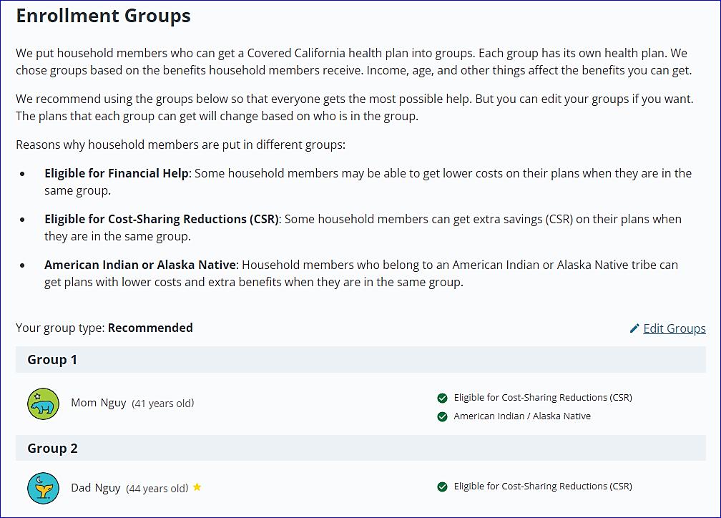
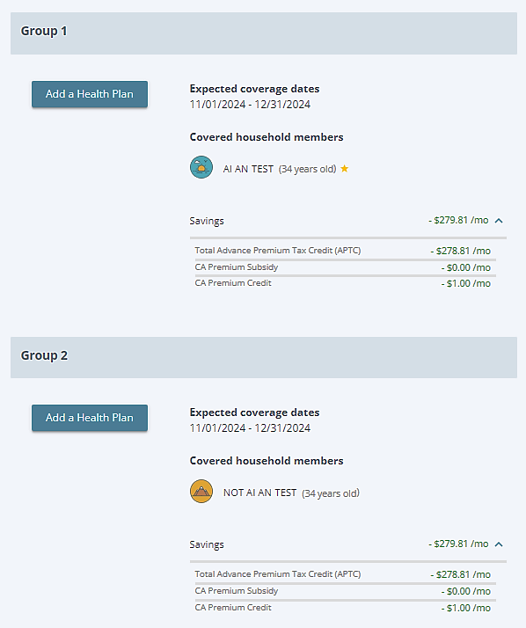
PLAN CHOICE FOR MIXED AI/AN HOUSEHOLDS
On selecting Shop for Health Plans, the online application system creates separate default groups:
Federally recognized AI/AN members are grouped together and Non-AI/AN members are in a separate group, since they qualify for different benefits.
Once you finalize your grouping, the system will give you a summary of your expected coverage and savings for each member
Notes:
We also recognize that American Indian and Alaska natives are mixed when it comes to their household.
The online application Automatically creates separate default groups for mixed tribal households.
o This means that federally recognized AI/AN household members are grouped together and non-AI/AN household members are displayed in a separate group.
This helps maximize benefits and savings that federally recognized AIAN folks may be eligible for
o The family may choose to group members differently by using the Edit option on the Create Your Groups page.

Slide 24
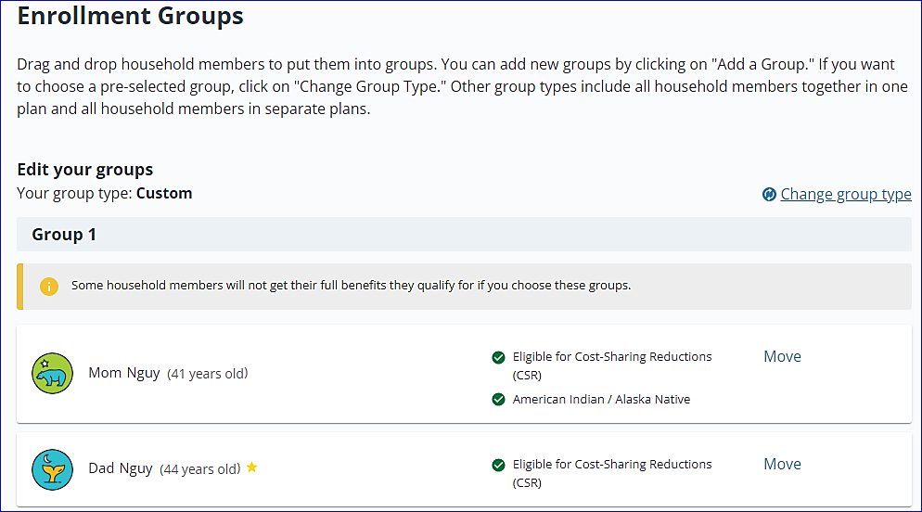
PLAN CHOICE FOR MIXED AI/AN HOUSEHOLDS
If you choose to create a custom/mixed group:
Cannot select AI/AN zero or limited cost-share plans.
May choose a standard plan with APTC (and CSR if applicable) for the entire household.
The system will show a warning sign that your grouping may not give members the full benefits that they may be eligible for
Notes:
If a mixed group is created that contains both federally recognized AI/AN and non-AI/AN members, the group will not be able to select an AI/AN zero cost-share or AI/AN limited cost-share plan.
o The household may choose a standard plan, with APTC (and CSR if applicable), that the household, including non-AI/AN members may enroll in together.
If you’d like to keep editing your grouping, you may do so by using the change group type option highlighted above
So, if you want to group folks in your household that are American Indian and Alaska native with non-American Indian Alaska natives, you can certainly do that. It’s another way for us to be able to provide you with choices to make the decisions that are best for you and your family. But you will get a little warning message from us letting you know that some household members WILL NOT get their full benefits that they qualify for.
As discussed earlier, Federally recognized Ai/AN members can enroll at anytime and do not need to wait for open enrollment or have a special enrollment reason. CCA also extends this advantage to non-AIAN family members if they are part of the same application.

Slide 25
Proof of American Indian and Alaska Native Status
Submit a copy of one of the following documents for verification:
Tribal Enrollment/Membership Card.
Authentic document from a tribe declaring membership for an individual.
I-872 American Indian Card.
U.S. American Indian/Alaska Native tribal enrollment or shareholder documentation.
Enrollment or membership document from a federally-recognized tribe or the Bureau of Indian Affairs. It must be on tribal letterhead or an enrollment/membership card that contains the tribal seal and/or an official signature.
Document issued by an Alaska Native village/tribe, or an Alaska Native Corporation Settlement Act (ANCSA) regional or village corporation acknowledging shareholder status.
Certificate of Degree of Indian Blood (CDIB) issued by the Bureau of Indian Affairs or a tribe, if the CDIB includes tribal enrollment information.
Letter from the U.S. Department of Health and Human Services (HHS) granting a tribal exemption based on tribal membership or Alaska Native shareholder status
Notes:
This is an outline of the different ways you can provide proof of your AIAN identity and that you belong to a federally recognized tribe so you can avail the benefits that the Federal government has defined under the ACA. State recognized tribes are usually only eligible for state subsidies.

Slide 26
What tribal income is counted*?
Income Type | MAGI Medi-Cal | Covered CA APTC/CSR*
Indian financing grants under title IV of the Indian Financing Act of 1974 to expand profit-making Indian-owned economic enterprises on or near reservations | Not counted | Not counted
Per-capita distributions of Indian gaming revenue | Count Taxable Portion | Count Taxable Portion
Public assistance payments, general assistance, Bureau of Indian Affairs general assistance | Not counted | Not counted
Distributions from Alaska Native corporations and settlement trusts | Not counted | Count taxable portion
Payments resulting from ownership interest in or usage rights to items that have a unique religious, spiritual, traditional, or cultural significance or rights that support subsistence or a traditional lifestyle according to applicable Tribal Law or custom | Not counted | Count taxable portion
Student financial aid provided under the Bureau of Indian Affairs education programs | Not counted | Count taxable portion
Distributions from Alaska Native corporations and settlement trusts | Not counted | Count taxable portion
*Full List: https://www.dhcs.ca.gov/services/medi-cal/eligibility/Documents/Co-OPS-Sup/Income-and-Deductions-Chart06252021.pdf
**Advance Premium Tax Credits/Cost Sharing Reductions

Slide 27
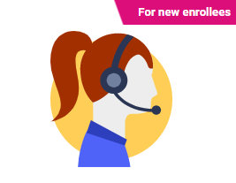
Enrollment in Covered California
Find a Storefront
Find a Licensed Insurance Agent
They are Certified Enrollers who are ready to help
Help On-Demand
Have a certified enroller call you. Most calls are returned in under 20 minutes.
Storefront / Enrollment Offices
Find a place to enroll in your area. Appointments and walk-ins available.
Call Us
Speak with a service center representative during our regular business hours.
Online Application
Create your application account, provide required information, select a plan, pay your premium.
Get Personalized Help
Get a Call
Find a Storefront
(800) 300-1506
CoveredCA.com
It's easy! Apply on our website at CoveredCA.com or get free, confidential help by dialing 800.300.1506.
Covered California and Medi-Cal use the same application. This means that once you apply, you’ll find out which program you qualify for (some households qualify for both).
Notes:
There is a variety of ways that individuals can enroll through covered California. They can go through a licensed insurance agent, we also have a help on demand feature where you can go and put in your information and then get a call within 20 minutes. You can go in person to a store front or an enrollment office that is located within your community. You can call us on our service center, and they should be able to help you, or you can apply online.
Issues from last year regard unscrupulous agents: : Covered California has rules in place for Agent/Brokers specific to gaining consumer consent for delegation. There are occasional complaints about plan switching or agent switching, they do not appear to be prevalent issues.
All of our certified agents are bound by an Agent Contract and an Agent Code of Conduct. Covered California’s Integrated Fraud Management Unit investigates consumer complaints and the department takes action depending on the facts of the case. Action may include an agent education letter, a cease and desist letter, a suspension, or a termination of the agent’s certification. Covered California may also refer misconduct allegations or findings to the California Department of Insurance for further investigation.

Slide 28
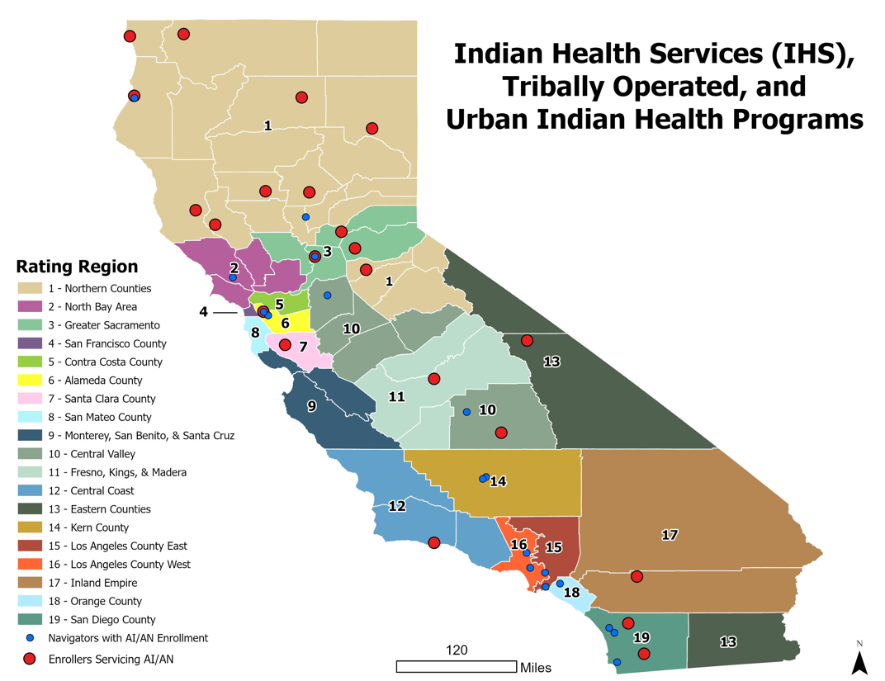
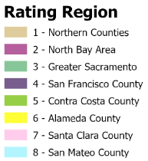
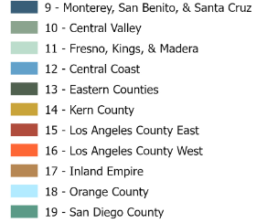
CERTIFIED ENROLLMENT ENTITIES
Account Name | Program | Organization Type
American Indian Health and Services, Inc | Certified Application Entity | American Indian Tribes or Tribal Organizations
Chapa-De Indian Health | Certified Application Entity | Licensed health care clinics
Consolidated Tribal Health Project, Inc | Certified Application Entity | American Indian Tribes or Tribal Organizations
Elk Valley Rancheria | Certified Application Entity | American Indian Tribes or Tribal Organizations
Feather River Tribal Health, Inc | Certified Application Entity | Indian Health Services Facilities
Fresno American Indian Health Project | Certified Application Entity | American Indian Tribes or Tribal Organizations
Indian Health Center of Santa Clara Valley | Certified Application Entity | Licensed health care clinics
Indian Health Council, Inc. | Certified Application Entity | Indian Health Services Facilities
Karuk Tribe | Certified Application Entity | American Indian Tribes or Tribal Organizations
Lake County Tribal Health Consortium, Inc. | Certified Application Entity | American Indian Tribes or Tribal Organizations
Lassen Indian Health Center | Certified Application Entity | American Indian Tribes or Tribal Organizations
MACT Health Board, INC. | Certified Application Entity | American Indian Tribes or Tribal Organizations
Native American Health Center | Navigator Entity (sub) | Non-Profit
Northern Valley Indian Health, Inc. | Certified Application Entity | Indian Health Services Facilities
Pit River Health Service, Inc | Certified Application Entity | American Indian Tribes or Tribal Organizations
Riverside San Bernardino Co Indian Health | Certified Application Entity | Indian Health Services Facilities
Sacramento Native American Health Center, Inc | Certified Application Entity | Licensed health care clinics
Shingle Springs Tribal Health Program | Certified Application Entity | American Indian Tribes or Tribal Organizations
Southern Indian Health Council, Inc. | Certified Application Entity | American Indian Tribes or Tribal Organizations
Toiyabe Indian Health Project | Certified Application Entity | American Indian Tribes or Tribal Organizations
Tule River Indian Health Center, Inc. | Certified Application Entity | Indian Health Services Facilities
United Indian Health Services | Certified Application Entity | Licensed health care provider
Notes:
And we have thousands of enrollment and Community partners throughout the state We partner with a lot of tribal organizations that target tribal populations. And so, they’re certified through either our navigator grant or they have somebody on their staff that is a certified enrollment partner who is familiar with the process, they should be able to enroll you.

Slide 29
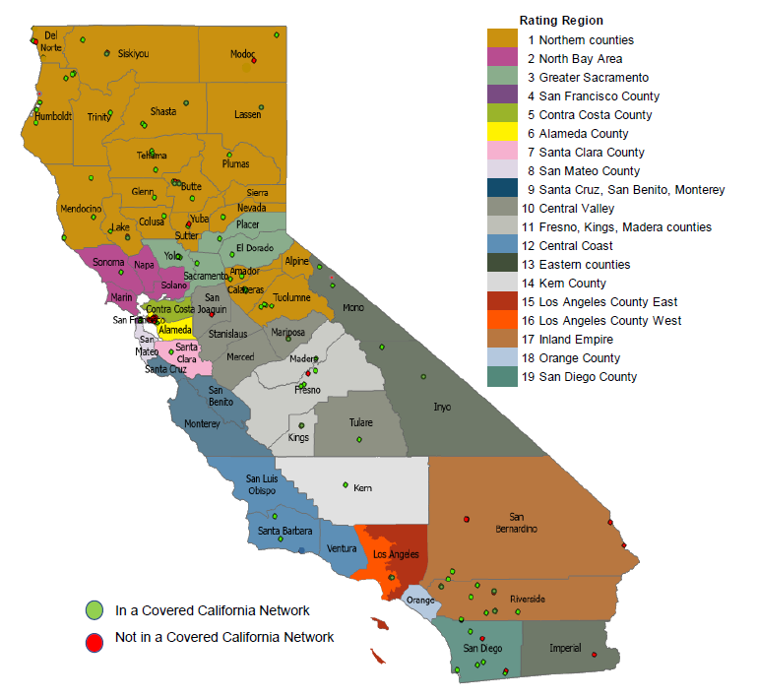
Covered California QHP Ai/an network
There are currently 85 Indian Health Service (IHS), tribally operated, and urban Indian health programs in Covered California’s QHP networks
Majority are in Region 1 (Northern CA) and Region 17 (Inland Empire)
Covered California continues to encourage QHP Issuers to include and expand the number of Indian Health Service (IHS), tribally operated, and urban Indian health programs in their networks
A list of Indian Health Service (IHS), tribally operated, and urban Indian health programs that are currently in Covered California’s QHP networks are available on the AI/AN toolkit:
https://hbex.coveredca.com/california-tribes/
Notes:
AS discussed earlier, Covered California contracts with individual health plans to offer health insurance plans to consumers. Each Qualified Health Plan (QHP) curates and manages their own network of hospitals and providers. Covered California encourages its QHPs to include Indian Health Service (IHS), tribes and tribal organizations, and urban Indian organization providers in their networks. We can see a map of I/T/U providers in California, along with a link to the provider roster and the plan networks they are part of. These resources are an ongoing work in progress as plan networks change over time. And so, if you're interested in knowing which ones are already contracted with our health plans, you can view the list on our website or you can type in your email address in the chat and we can send it your way as well.

Slide 30
QUESTIONS

Slide 31
THANK YOU! TRIBALCONSULTATION@COVERED.CA.GOV
Waynee Lucero Tribal Liaison and Deputy Director Waynee.Lucero@covered.ca.gov

Slide 32
APPENDIX

Slide 33
AMERICAN INDIAN/ALASKA NATIVE ELIGIBILITY: ZERO COST SHARE PLANS
AI/AN applicants are eligible for a zero-cost sharing qualified health plan (QHP) if the applicant:
Meets the eligibility requirements for APTC (Advance Premium Tax Credit) and CSR (Cost Sharing Reduction)
Is expected to have a household income between 100 percent and 300 percent of the federal poverty level (FPL) for the benefit year for which coverage is requested
Is a member of a federally-recognized tribe
If the AI/AN applicant meets the above eligibility requirements for Zero Cost Sharing plans, the QHP issuer must eliminate any cost sharing.
AI/AN enrollees can only access these benefits if enrolled in a Zero Cost Sharing plan through Covered California.
Notes:
https://www.nihb.org/docs/05142010/Affordable_Care_Act_Provisions_Summary.pdf
What type of coverage does Covered California offer

Slide 34
AMERICAN INDIAN/ALASKA NATIVE ELIGIBILITY: LIMITED COST SHARE PLANS
AI/AN applicants are eligible for Limited Cost Sharing plans at every metal level if the applicants:
Household income is below 100 percent or exceeds 300 percent of the FPL for the benefit year for which coverage is requested, or income is not reported
Are a member of a federally recognized tribe
If the AI/AN applicant meets the above eligibility requirements for Limited Cost Sharing plan, the QHP issuer must:
Eliminate any cost sharing under the plan for the services or supplies received directly from an Indian Health Service, an Indian Tribe, Tribal Organization, or Urban Indian Organization, or through Purchased Referred Care
Apply standard cost sharing for the QHP’s provider network outside of Indian and Tribal providers
AI/AN enrollees can only access these benefits if enrolled in a Limited Cost Sharing plan through Covered California.
Notes:
What type of coverage does Covered California offer

Slide 35
COVERAGE FOR OUT-OF-NETWORK SERVICES
The requirement for a QHP issuer to offer Zero Cost Share or Limited Cost Share benefits applies to “covered services” under the plan.
QHP issuers are not required to offer Zero Cost Share or Limited Cost Share benefits for services received from out-of-network providers.
American Indian/ Alaska Native enrollees would be responsible for 100% of the cost of services received from out-of-network providers when enrolled in a plan with a closed provider network.
Closed provider networks include:
Health Maintenance Organizations (HMO)
Exclusive Provider Organizations (EPO)

Slide 36
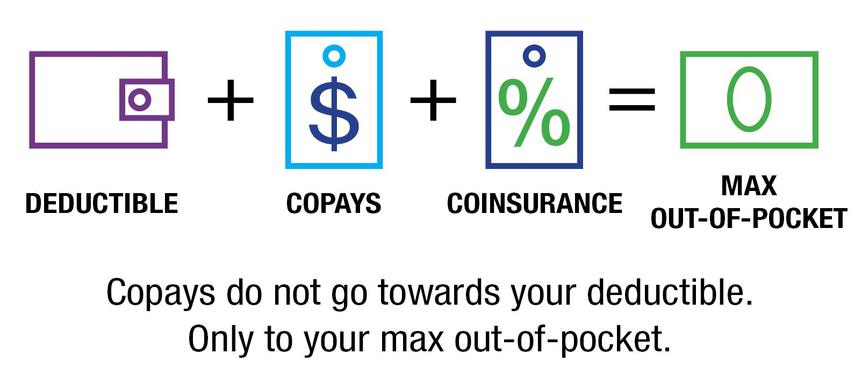
GLOSSARY
Copays:
A fixed amount (for example, $15) you pay for a covered health care service, usually when you receive the service. The amount can vary by the type of covered health care service.
Premium:
A health insurance premium is the recurring payments you make to manage your health insurance plan.
Coinsurance:
Your share of the costs of a covered health care service, calculated as a percentage (for example, 20 percent) of the allowed amount for the service. You pay coinsurance plus any deductible you owe.
Deductibles:
The amount you owe for health care services your health insurance plan covers before your plan begins to pay. For example, if your deductible is $1,000, your plan won’t pay anything until you have met your deductible for covered health care services. The deductible may not apply to all services.
Maximum Out-of-pocket (MOOP):
The most you have to pay for covered services in a plan year. After you spend this amount on deductibles, copayments and coinsurances for in-network care and services, your health plan pays 100% of the costs of covered benefits.
Additional Resources: www.coveredca.com/support/glossary/

Slide 37
GLOSSARY
Advanced Premium Tax Credit (APTC)
Financial assistance eligible consumers may receive when enrolling in a Covered California health insurance plan, to assist them in paying their monthly premium costs. The amount of premium assistance an individual may receive is determined based on his or her income as a percentage of the federal poverty level. This tax credit may also be described as “premium assistance.” Tax credits are also available to small businesses with fewer than 25 full-time-equivalent employees to help offset the cost of providing coverage
Exclusive Provider Organization (EPO)
An exclusive provider organization (EPO) is a type of health care doctor and hospital network that offers a full array of covered benefits from a single network. Covered benefits are not paid for services rendered by a doctor or hospital that is not part of the network, except in the case of emergency or plan-approved care outside the network.
Federal Poverty Level (FPL)
A measure of income level issued annually by the U.S. Department of Health and Human Services. Federal poverty levels are used to determine eligibility for certain programs and benefits. In California, for example, Medi-Cal is available to those making up to 138 percent of the federal poverty level.
Federally Recognized Tribe
Any American Indian or Alaska Native tribe, band, nation, pueblo, village or community that the U.S. Department of the Interior acknowledges to exist as an American Indian tribe.
Health Maintenance Organization (HMO)
A type of health insurance plan that usually limits coverage to care from doctors who work for or contract with the health maintenance organization (HMO). It generally won’t cover out-of-network care except in an emergency. An HMO may require you to live or work in its service area to be eligible for coverage. HMOs often provide integrated care and focus on prevention and wellness.
Preferred Provider Organization (PPO)
A type of health insurance plan that contracts with participating doctors and hospitals to create a network. You pay less if you use doctors and hospitals that belong to the plan’s network. You can use doctors, hospitals and others outside the network for an additional cost.
Additional Resources: www.coveredca.com/support/glossary/

Slide 38
Covered California Supplemental Slides
May 2025
Notes:
Good morning, everyone. Welcome and Thank you for joining us today.

Slide 39
Federal update: impact of expiration of enhanced federal subsidies

Slide 40
Expanded affordability from the enhanced premium tax credit
The federal enhanced premium tax credit (ePTC) has dramatically increased affordability for marketplace consumers by:
Increasing the amount of financial help for all consumers eligible to receive the advanced premium tax credit (APTC).
Providing two free Silver plan options for consumers with incomes below 150% FPL ($22,590 for an individual and $46,800 for a family of four).
Eliminating the “subsidy cliff” for middle-income consumers above 400% FPL who were previously ineligible for APTCs ($60,240 for an individual and $124,800 for a family of four).
The savings from the enhanced tax credit have been substantial for Federally Recognized AI/AN consumers:
On average, consumers save an additional $92 on premium costs each month.
More than half of consumers pay less than $10 per member per month for coverage.
More than 665 middle-income enrollees are now receiving a tax credit for their coverage where previously no financial help was available.
See Appendix for 2025 federal poverty level values.

Slide 41
PREMIUMS WILL INCREASE IF THE ENHANCED PREMIUM TAX CREDIT EXPIRES
Consumers with incomes less than 400% FPL ($60,240 for an individual), could see, on average, a $58 monthly increase in net premiums without the enhanced premium tax credit.
More than 665 AI/AN consumers with incomes over $60,240 will lose eligibility for tax credits entirely.
A publicly-available data book comparing consumer net premiums under the Affordable Care Act and Inflation Reduction Act is available online and includes AI/AN data based on self-identified race.
Under 400% FPL
Under 150% FPL
150% - 200% FPL
200% - 250% FPL
250% - 400% FPL
Source: Snapshot of January 2025 Covered California among Federally Recognized Tribal Members receiving monthly APTC. Income levels reflect plan year 2025 FPL for an individual.

Slide 42
TIMING CONSIDERATIONS FOR EXTENSION OF THE ENHANCED PREMIUM TAX CREDIT
Without Congressional action, the enhanced premium tax credit will expire at the end of 2025.
Covered California and marketplaces across the country are currently preparing for the 2026 plan year, but uncertainty around the extension of the enhanced premium tax credit will make projections challenging.
Health insurance company premium rates were due to Covered California at the end of April. This is to allow consumers notice of changes in their costs well in advance of commencement of the next open enrollment period on November 1, 2025.
Without extension of the enhanced premium tax credit, higher proposed rates, fewer enrollees, and market instability are likely.
Urgent action on extension of the enhanced premium tax credit would prevent rate hikes and create more certainty in the market while maintaining affordable continuous coverage for enrollees.

Slide 43
INFORMING FEDERAL POLICY
Covered California continues to engage with Congress and the federal administration to inform the federal policy dialogue surrounding the expiration of federal enhanced premium tax credits.
In February, Covered California traveled to Washington, D.C. to brief members of congress on the impacts of enhance premium tax credit expiration. Covered California developed an issue brief series outlining statewide impacts, as well as impacts to self-employed, older enrollees, rural enrollees, and communities of color.
In May, joined by state-based marketplaces from across the country, Covered California returned to Washington, D.C. to engage with federal administration officials. Covered California will also meet with key California congressmembers to discuss enhanced premium tax credits and the importance of taking action to extend them.
Covered California continues to engage with stakeholder partners and policy leaders at state and national levels who are vested health care access and affordability.

Slide 44
CMS Proposed Marketplace Integrity and Affordability Rule

Slide 45
PROPOSED RULE overview
On March 19, 2025, CMS issued a proposed rule aimed at addressing concerns of fraud, waste, and abuse occurring in marketplace coverage. The proposed rule introduces several changes to eligibility, enrollment, and affordability and coverage requirements.
Notably, the proposed changes:
Impose substantial administrative and financial burdens on consumers, especially in Covered California and other state-based marketplaces that have not experienced widespread fraud.
Mark a departure from the CMS's historical flexibility for state-based marketplaces, mandating uniform policy adoption rather than providing states with the discretion to align with federal policy or choose their own.
Reflect the new administration's priorities, seeks to reverse expansions for DACA recipients and excludes gender affirming care from Essential Health Benefits.

Slide 46
POTENTIAL IMPACTS ON AI/AN MEMBERS
Direct Impacts:
Pre-enrollment SEP Verification: Would require marketplaces to conduct pre-enrollment verification for at least 75% of all new Special Enrollment Period (SEP) selections
This would not impact new enrollments in the AI/AN SEP, as AI/AN status is already verified as part of the eligibility determination
May affect new enrollments in other SEPs, if the SEP is among those 75% requiring pre-enrollment verification
Bronze-to-Silver Affordability Crosswalk Elimination: Would eliminate states' ability to automatically reenroll cost-sharing reduction eligible consumers from a bronze to a silver plan
Impacts only AI/AN members in limited cost-sharing plans
Zero cost-sharing AI/AN members are excluded from the Affordability Crosswalk
Broader Rule Provisions Impacting All, Including AI/AN:
Payment of Past-Due Premiums: Would allow health plans to require consumers pay any past-due premiums owed before enrolling in new coverage
Shortened Open Enrollment Period: Would require all marketplaces to shorten their Open Enrollment Periods to run Nov 1–Dec 15. Federally recognized AI/AN will not be impacted but non-federally recognized AI/AN who indicate their race is American Indian will be.
Failure to Reconcile (FTR) APTC: Would modify the "failure to reconcile" process to determine an applicant ineligible for APTC if they failed to file taxes reconciling past APTC for one year (changed from two consecutive years)
Stricter Income Verification: Would impose additional requirements on income verification for APTC applicants
$5 Premium for Passive Renewals: Would eliminate automatic reenrollment for consumers who are in fully subsidized plans and instead charge them a $5 premium, which would be eliminated after the consumer confirmed their eligibility for the plan
Gender-Affirming Care: Would prohibit states from including “sex-trait modification” (gender-affirming care) as an Essential Health Benefit. Gender-affirming care will still be a covered benefit, however, APTC can not be used.

Slide 47
COVERED CALIFORNIA COMMENT LETTER
On Friday, April 11th, Covered California submitted a comment letter on the federal proposed rule offering feedback on specific proposals and emphasizing the overall importance of:
Preventing unnecessary consumer burdens: While there have been some identified issues of fraud on the federal marketplace, Covered California and state-based marketplaces (SBMs) more broadly have not experienced the same issues. With no indication of widespread fraud occurring in our markets, the proposed rule instead unnecessarily imposes substantial administrative and financial burdens on eligible consumers seeking to enroll.
Preserving state flexibility: The proposed rule diverges from past norms regarding the relationship between CMS and State Based Marketplaces (SBM) and is very prescriptive in its intent that SBMs implement all the same policies as the federal marketplace. Historically, SBMs have been given discretion in many of these areas to align with federal policy or choose a different approach.
Upholding California values: The proposed rule diverges from California’s core values of safeguarding the rights of all communities and empowering all individuals to lead healthier, happier lives.

