Slide 1





With You Through Life’s Journey…
Michael Teixeira| Public Affairs Specialist
Produced at U.S. taxpayer expense
Notes:
Whether you are about to retire, become a full time grandparent, or start a new chapter in life, Social Security is here to help you secure today and tomorrow with financial benefits, information, and tools that provide a safety net throughout life’s journey.

Slide 2
Objectives
How Retirement Benefits Work Planning For Retirement Deciding When To Start Retirement Benefits What Else Affects Your Retirement Benefits What about Medicare How to Apply

Slide 3
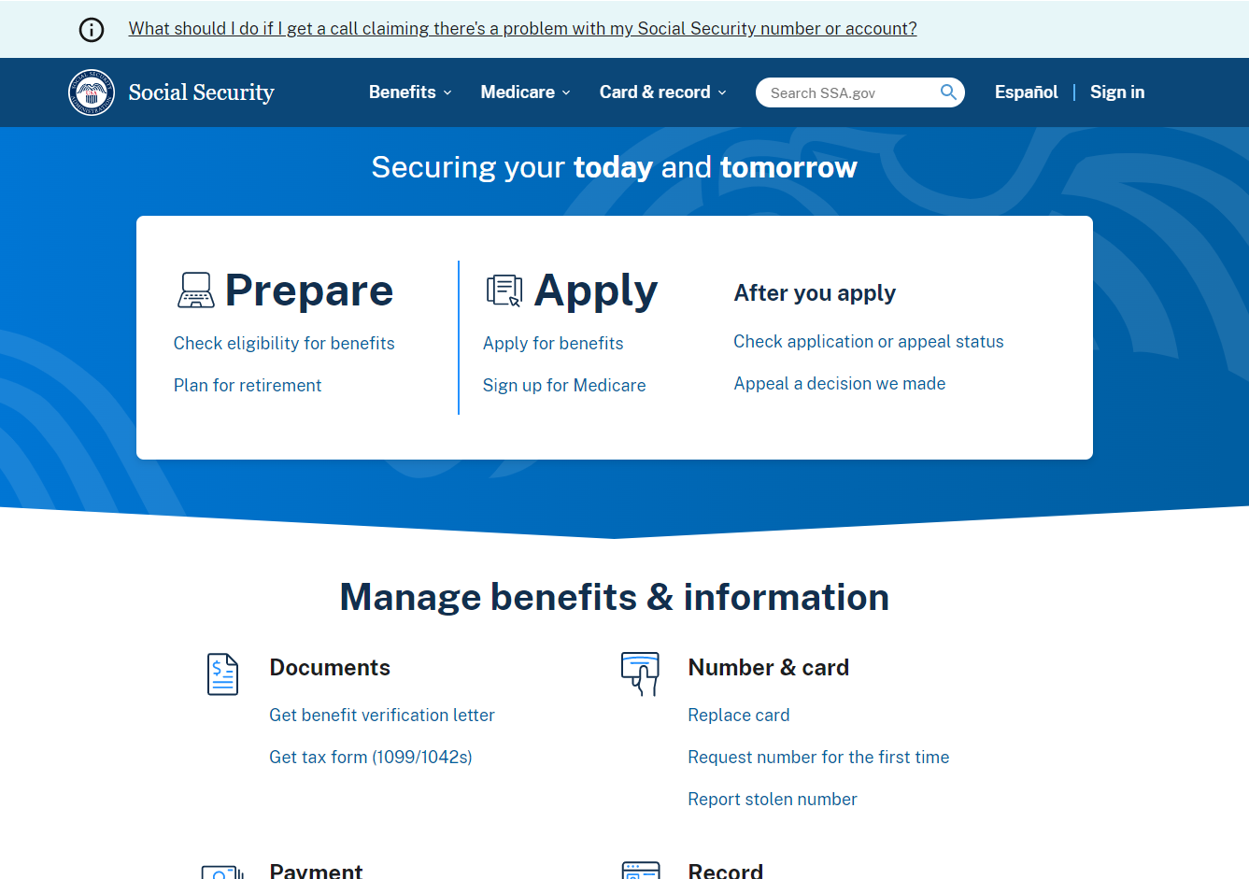
Social Security Website
Notes:
The Social Security website is a valuable resource of information about all of Social Security’s programs and is accessible from a computer, tablet and smartphone.
We encourage you to use our online retirement planning tools to plan for a secure financial future.

Slide 4

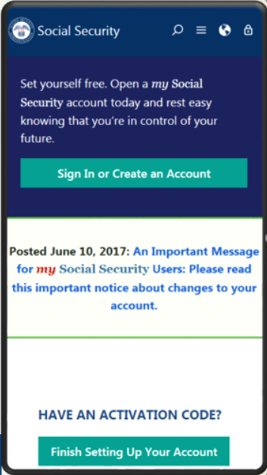
my Social Security
socialsecurity.gov/myaccount
Notes:
my Social Security is a convenient and secure suite of services designed to put you in control of your personal Social Security information, as well as help you manage your benefits when you are ready. Your account gives you the information you need whenever you want. All without calling or visiting a field office.
You can only open a my Social Security account for yourself. You cannot open an account for another person, even if you have his or her written consent. You may be unable to open a my Social Security account if you:
• Blocked electronic access to your personal Social Security information; • Recently moved or changed your name; or • Placed a freeze on your credit report.
Your online my Social Security account provides a variety of information to help you and your family. If you need help setting up your account, we have a 4-minute walkthrough video on our YouTube page.

Slide 5
my Social Security Services
If you do not receive benefits, you can:
View retirement benefit estimates at different ages or dates when you want to start receiving benefits;
View possible spouse’s benefits;
Request a replacement Social Security card if you meet certain requirements;
Check the status of your application or appeal;
Get a benefit verification letter as proof that you are not getting benefits;
Get your Social Security Statement to review:
Estimates of your future retirement, disability, and survivor benefits;
Your recent earnings history, to verify the amounts that we posted are correct; and
The estimated Social Security and Medicare taxes you’ve paid.
ssa.gov/myaccount/what.html
Notes:
Slide updated – minor edit – 7/14/2023 (DB/SY/JP)

Slide 6
my Social Security Services
Adults Who Receive Benefits or Have Medicare, Can:
Request a replacement Social Security card online if they meet certain requirements
Report wages if they are working and receiving Social Security Disability benefits and/or Supplemental Security Income payments
Print a benefit verification letter
Check benefit and payment information
Change their address and phone number (Social Security beneficiaries only)
Start or change direct deposit (Social Security beneficiaries only)
Request a replacement Medicare card
Get a replacement SSA-1099 or SSA-1042S for tax purposes
Receive notices online, including their cost-of-living Adjustment (COLA) notice, sooner than they would receive them in the mail.
Notes:
Individual representative payees with a my Social Security account can conduct their own business or manage direct deposit, wage reporting, and annual reporting for their beneficiaries through the Representative Payee Portal.
You also have the option to advance designate a representative payee. Advance designation allows capable adults who are applying for or receiving benefits to designate up to three individuals who could serve as a representative payee if the need ever arises. This feature can be managed through your personal my Social Security account.
Slide and Speaker Notes updated 12/17/2024 (SY)

Slide 7
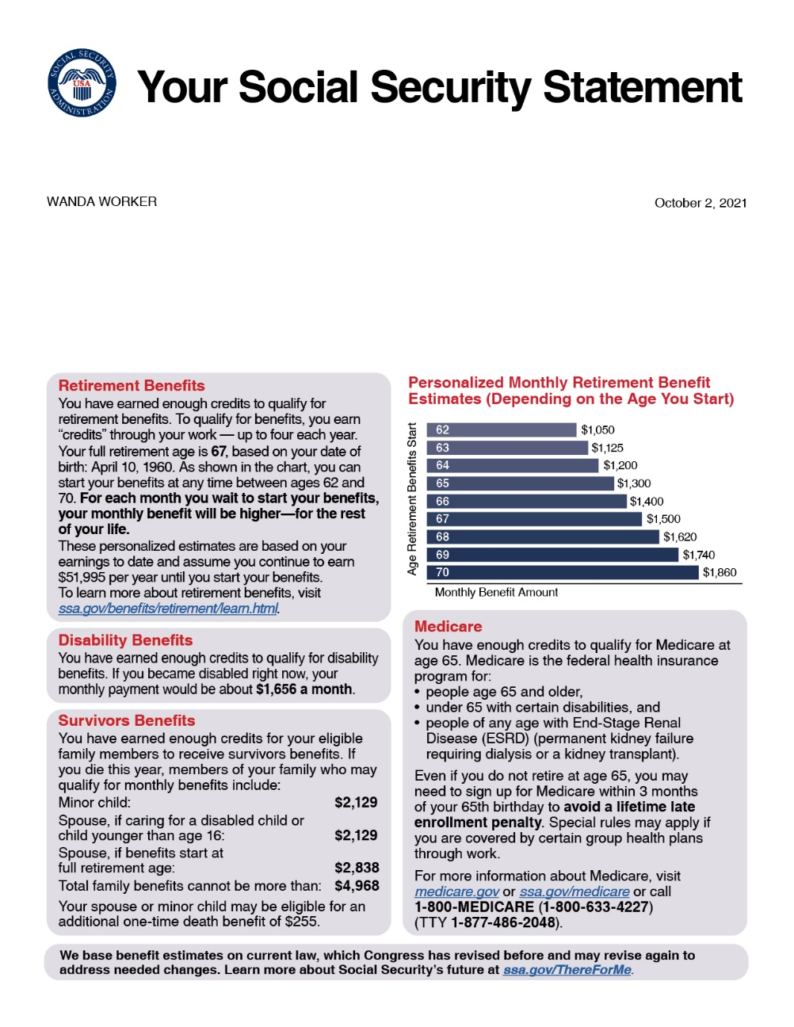
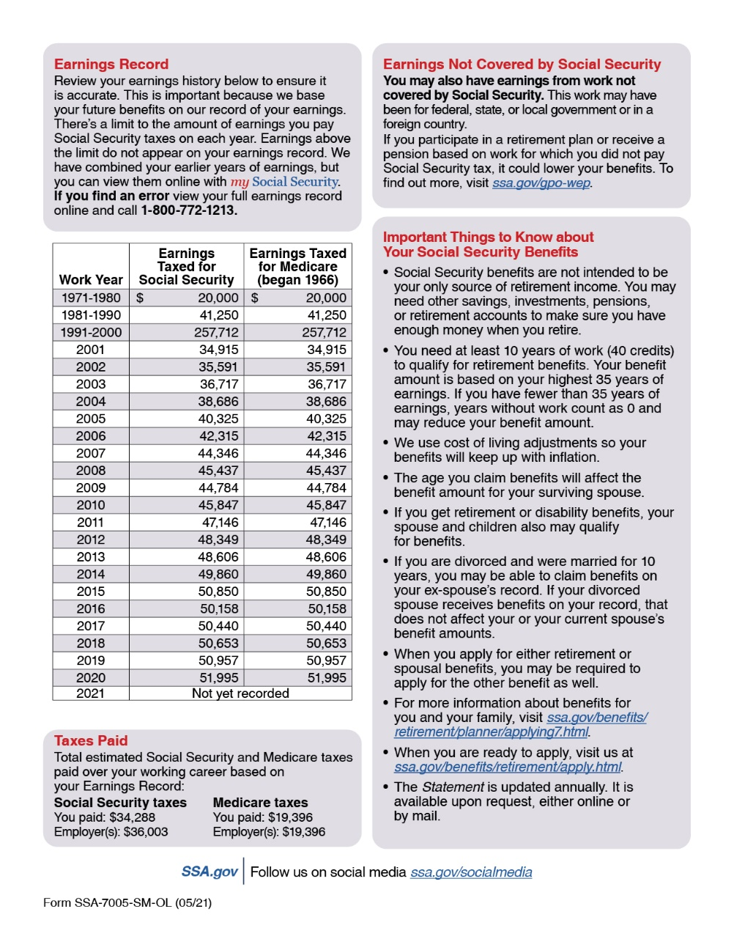
Social Securiaaty Statement
Notes:
* New redesigned Statement:
Plain language, design, and graphics make it easier to find information.
For example, we now provide a graph with retirement benefit estimates for up to 9 ages, depending on when you want benefits to start.
* The Statement is one of Social Security’s most far-reaching educational tools.
- In 2022, we provided more than 38 million Statements in print and online.
* Workers age 18 and older can access their Statement online using my Social Security.
We mail a Statement to workers age 60 and older who do not have an online account.
Anyone can send in a written request to have a Statement mailed to them.
Speaker notes updated 11/3/2022 (SY/JP)

Slide 8
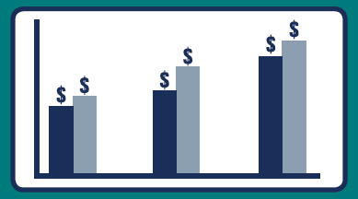
The my Social Security Retirement Calculator
Compare your individualized retirement benefit estimates at age 62, Full Retirement Age, and age 70
You can also select the age in years and months or the date you want to begin retirement benefits between ages of 62 - 70.
Input your expected average future annual income.
Your retirement estimates are provided in both written and chart form.

Slide 9
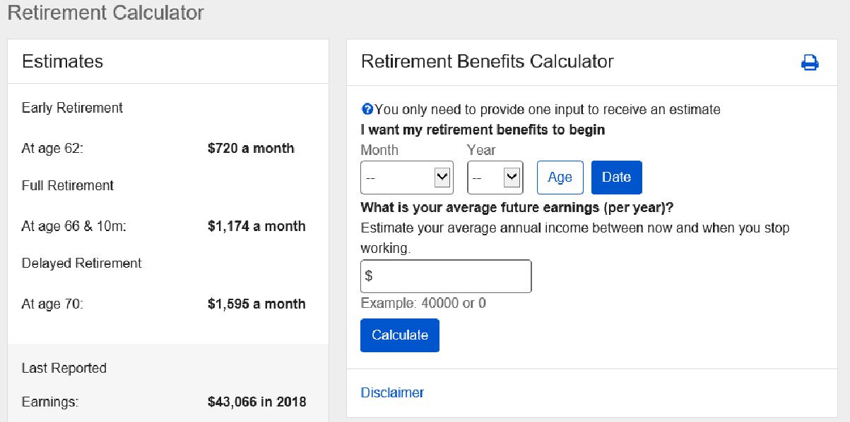
my Social Security Services: Retirement Calculator

Slide 10
How Do You Become Eligible for Retirement Benefits?
By earning “credits” when you work and pay Social Security taxes
You need 40 credits (10 years of work) and you must be 62 or older
In 2025, each $1,810 in earnings gives you one credit
You can earn a maximum of 4 credits per year
Note: To earn 4 credits in 2025, you must earn at least $7,240.
ssa.gov/benefits/retirement/planner/credits.html
Notes:
Credits are the "building blocks" Social Security uses to find out whether you have the minimum amount of covered work to become eligible for each type of Social Security benefit. If you stop working before you have enough credits to be eligible for benefits, your credits will stay on your record. If you return to work later, you can add more credits so you can become eligible. No benefits can be paid if you do not have enough credits.
In 2025 you must earn $1,810 in covered earnings to get one Social Security or Medicare work credit and $7,240 to get the maximum four credits for the year.
When you work and pay Social Security taxes, you earn up to a maximum of four "credits" for each year.
During your lifetime, you will probably earn more credits than the minimum number you need to be eligible for benefits; however, these extra credits do not increase your benefit amount.
Your average earnings during your working years determine how much your monthly payment will be.
Publications:
ssa.gov/pubs/EN-05-10003.pdf (Update)
ssa.gov/pubs/EN-05-10072.pdf (How You Earn Credits)
Slide and Speaker Notes updated 11/5/2024 (SY)

Slide 11


How Social Security Determines Your Benefit
Social Security benefits are based on earnings
Step 1 - Your wages are adjusted for changes in wage levels over time
Step 2 - Find the monthly average of your 35 highest earnings years
Step 3 -Result is “average indexed monthly earnings”

Slide 12

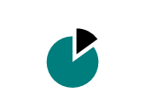

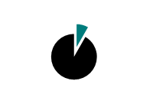
2025 Retirement Benefit Formula
If your average monthly earnings are = $8,000
Then your monthly benefit would be = $3,167
Average Monthly Earnings = $8,000
90% of First $1,226 | $1,226 | = $1,103
32% of earnings between $1,226 and $7,391($7,391 - $1,226 = $6,165) | $6,165 | = $1,973
15% of Earnings over $7,391 | $609 | = $91
Total monthly benefit | $8000 | = $3,084
*Payments rounded to whole dollar amounts

Slide 13
Retirement Benefit Filing
Strategies & Options

Slide 14

62
Earliest Age to Retire
with permanent reduction of benefits

Slide 15
Benefits Chart by Age
Year of Birth | Full Retirement Age | A $1000 retirement benefit taken at age 62 would be reduced by | A $500 spouse benefit taken at age 62 would be reduced by
1943-1954 | 66 | 25% | 30%
1955 | 66 and 2 months | 25.83% | 30.83%
1956 | 66 and 4 months | 26.67% | 31.67%
1957 | 66 and 6 months | 27.5% | 32.5%
1958 | 66 and 8 months | 28.33% | 33.33%
1959 | 66 and 10 months | 29.17% | 34.17%
1960 + | 67 | 30% | 35%
ssa.gov/oact/quickcalc/earlyretire.html
Notes:
Remember that when to start receiving retirement benefits is a personal choice. There isn’t a one fits all answer.
You should make an informed decision about when to apply for benefits based on your individual and family circumstances.
Factors you should consider when deciding the best age to retire:
Your current cash needs;
Your health and family longevity;
Whether you plan to work in retirement;
Whether you have other retirement income sources;
Your anticipated future financial needs and obligations; and,
The amount of your future Social Security benefits.
This chart gives an example of how much a $1,000 retirement benefit and a $500 retirement benefit would be reduced if someone took the benefit at age 62.
The increase in full retirement age was the result of the 1983 Amendments to the Social Security Act. Full retirement age increases apply to both Retirement Benefits and Survivors Benefits. Although Social Security has always used the term “full” retirement age, you may find that some people now refer to “full retirement age” as the “Normal Retirement Age”. Regardless of your full retirement age, reduced benefits can still be paid as early as age 62.
In addition, the Medicare eligibility age of 65 has not changed. We recommend that you apply for Medicare 3 months before your 65th birthday (unless you are already receiving Social Security benefits when you turn 65, in which case you will be automatically enrolled in Medicare).
Source: ssa.gov/oact/quickcalc/earlyretire.html
8/16/2022 - Speaker notes updated (AW)

Slide 16

70
Max Delayed Retired Credit
+ 8% of Benefit per every year after
Full Retirement Age

Slide 17
Working While Receiving Benefits
If you are | In 2025, you can earn up to | If you earn more, some benefits will be withheld
Under Full Retirement Age | $23,400/yr. | $1 for every $2 earned above the limit
The Year Full Retirement Age is Reached | $62,160/yr. before month of full retirement age | $1 for every $3 earned above the limit
Month of Full Retirement Age and Above | No Limit | No Limit
Retirement Earnings Test Calculator:
ssa.gov/OACT/COLA/RTeffect.html
Notes:
The first thing we recommend is that you visit ssa.gov/pubs and search for the publication entitled, How Work Affects Your Benefits. It explains the rules you must follow in order to avoid an overpayment, and it gives some great examples for different scenarios that could apply to your individual situation.
You can get Social Security retirement or survivors benefits and work at the same time. However, if you’re younger than full retirement age, and earn more than certain amounts, your monthly benefit remains the same but the total amount of benefits you receive for the year will be reduced. The amount that your annual benefits are reduced, however, isn’t truly lost. Your monthly benefit will be increased at your full retirement age to account for benefits withheld due to earlier earnings.
Note that spouses and survivors who receive benefits because they have minor children or children in their care with a disability, don’t receive increased benefits at full retirement age if benefits were withheld because of work.
I should also mention that different rules apply if you work outside the United States, where benefit withholding may apply if you work more than a certain number of hours in a month. Contact us if you’re working (or plan to work) outside the country. You can also read how working outside the United States affects your benefits in the publication, Your Payments While You Are Outside the United States.
But for most of you, here’s how this works. If you work, and are full retirement age or older, you may keep all of your benefits, no matter how much you earn.
If you’re younger than full retirement age, there is a limit to how much you can earn and still receive full Social Security benefits. If you’re younger than full retirement age, we must deduct $1 from your benefits for each $2 you earn above the annual limit. For 2025, that limit is $23,400.
If you reach full retirement age during 2025, we must deduct $1 from your benefits for each $3 you earn above $62,160 until the month you reach full retirement age.
Starting with the month you reach full retirement age, there is no limit on how much you can earn and still receive all of your Social Security benefits.
Note: If some of your retirement benefits are withheld because of your earnings, your benefits will be increased starting at your full retirement age to take into account those months in which benefits were withheld.
Source:
OISP/OAESP ssa.gov/pubs/EN-05-10069.pdf (How Work Affects Your Benefits)
OISP/OSNIP ssa.gov/pubs/EN-05-10137.pdf (Your Payments While You Are Outside the United States) - Pages 12-16 contain the relevant information about the effect of work outside the U.S
Slide and Speaker Notes updated 11/5/2024 OAESP (SY)

Slide 18
What Income Counts Towards the Annual Earnings Limits?
Income that Counts as Earnings:
Gross wages from employment and/or net earnings from self employment
Income that Does NOT Count as Earnings:
Inheritance payments
Pensions
Income from investments
Interest and dividends
Capital gains
Other sources

Slide 19
Additional Family Benefits
Once you file an application (Retirement or Disability) additional family benefits can be considered
Social Security looks for eligible family members based on your answers to questions in your application
Minor children, adult children with childhood disabilities (disabling conditions that started prior to age 22) and spouses
Additional benefits do not reduce payment to the retired worker

Slide 20
Who Can Get Survivors Benefits?
Child | May receive benefits if unmarried and younger than age 18, or between ages 18 and 19 and a full-time student (no higher than grade 12)
Disabled Child | May receive benefits after age 18 if unmarried and has a disability that started before age 22
Widow/er or Divorced Widow/er (Remarriage after age 60 will not affect benefits) | May receive full benefits at full retirement age or reduced benefits: as early as age 60 as early as 50 and has a disability at any age if caring for a child of a deceased worker who is under age 16, has a disability, and receives child's benefits
**Lump Sum Death Payment ($255)

Slide 21
Medicare Benefits

Slide 22



Medicare Has Four Parts
Part A
Hospital
Part B
Doctor
Part C
Medicare Advantage
Combines
Parts:
A,B & D
Part D
Medicare Prescription
Drug Coverage
Notes:
Medicare is our country’s health insurance program for people age 65 or older. People younger than age 65 with certain disabilities, or permanent kidney failure, or amyotrophic lateral sclerosis (Lou Gehrig’s disease), can also qualify for Medicare. You have choices for how you get Medicare coverage – Original Medicare and Medicare Advantage.
Original Medicare includes Hospital (Part A) and Medical (Part B) insurance. If you want drug coverage, you can add a separate drug plan (Part D). You can also add a Medicare Supplement Insurance (Medigap) policy to help pay your out-of-pocket costs.
A Medicare Advantage Plan is an all-in-one alternative to Original Medicare. These "bundled" plans include Part A, Part B, and usually Part D. Most plans offer extra benefits— like vision, hearing, dental, and more.
==============
Medicare has 4 parts:
1. Part A is Hospital Insurance which covers most inpatient hospital expenses. The 2023 deductible for Part A is $1600.
2. Part B is Medical Insurance which covers 80% of doctor bills & other outpatient medical expenses after your first $226 in approved charges. The 2023 standard monthly premium is $164.90. There is no monthly premium for Part A if you are insured for retirement benefits. After you retire, your health insurance may require for Medicare to pay first. Many supplemental plans require you to sign up for Medicare Part B. The Medicare premium most beneficiaries pay represents 1/4 of the actual cost, and the Federal government covers the balance of the cost.
3. Medicare Advantage—also known as Part C— is an “all in one” alternative to Original Medicare. These “bundled” plans include Part A, Part B, and usually Part D. These plans may also have lower out-of-pocket costs and may offer extra benefits that Original Medicare doesn’t cover— like vision, dental, and more.
4. Part D is Medicare Prescription Drug coverage, which covers a major portion of your prescription drug costs. Your out-of-pocket costs—monthly premiums, annual deductible and prescription co-payments—will vary by plan. You enroll with a Medicare-approved prescription drug provider, not by contacting Social Security. Each Medicare Advantage plan can charge different out-of-pocket costs, but they must follow rules established by Medicare. Medicare-approved prescription drug plans cover a major portion of your prescription drug costs.
Learn more with our publication, Medicare, 05-10043. To learn more about Original Medicare, Medigap, or Medicare Advantage plans, visit medicare.gov/Publications/ to view CMS’ publication Choosing a Medigap Policy, Publication 02110, and Understanding Medicare Advantage Plans, Publication 12026.
Source: https://www.medicare.gov/basics/costs/medicare-costs
Speaker notes updated OISP/OEEMP 10/13/2022 (SY/JP)
Speaker notes updated 12/6/2022 (SY/JP)

Slide 23
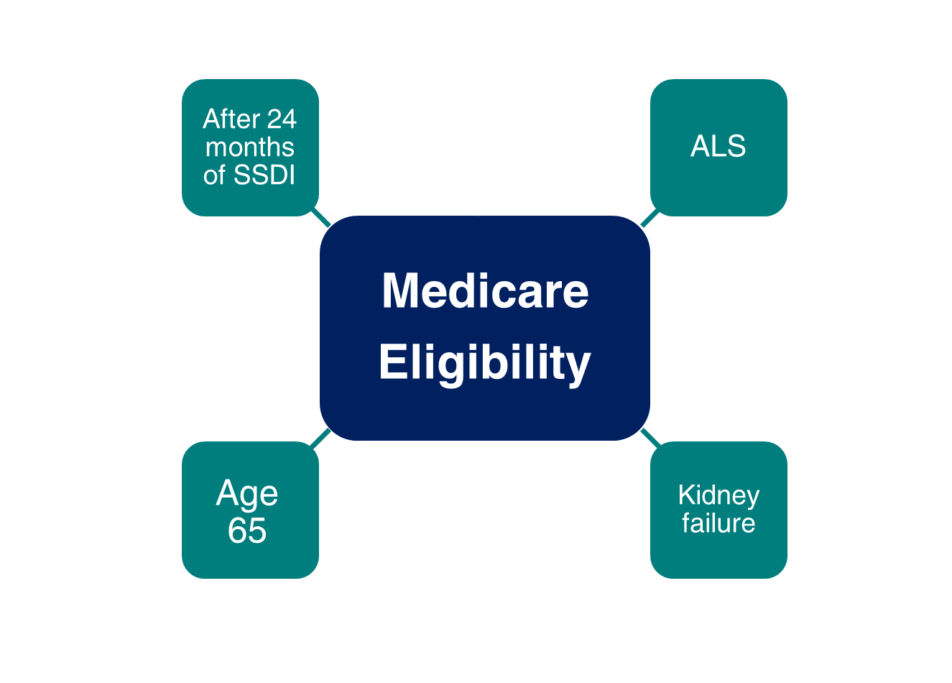
Medicare Eligibility
Notes:
Remember that although the full retirement age has increased above age 65, Medicare eligibility is still age 65. One of the most important things to remember is that you can apply for Medicare online, even if you are waiting past age 65 to apply for Social Security retirement benefits.
You should apply for Medicare 3 months before your 65th birthday, even when you plan to apply for your retirement or spouse’s benefits later.
If you are approved for Social Security disability benefits, you will be eligible for Medicare benefits 24 months from the month you were entitled to receive benefits, not from the first month you receive a payment.
If you are diagnosed with amyotrophic lateral sclerosis (Lou Gehrig’s disease) and you get disability benefits, you can get Medicare right away.
If you have permanent kidney failure and you receive maintenance dialysis or a kidney transplant – you may also be eligible for Medicare.
*Note to speaker: If an audience member asks about Medicare based on exposure to environmental health hazards,
provide this link: ssa.gov/OP_Home/ssact/title18/1881A.htm or HI 00803.001 https://secure.ssa.gov/poms.nsf/lnx/0600803001
Updated – OISP/OEEMP 10/13/2022 (SY/JP)
Speaker Notes updated 12/6/2022 (SY/JP)

Slide 24
Medicare Enrollment Periods
Enrollment Period: | When the period occurs:
Initial Enrollment Period – Your first opportunity to enroll | 3 months before you turn age 65, the month you turn age 65, and 3 months after you turn age 65
General Enrollment Period | Annually, January 1 – March 31
Special Enrollment Period | During any month you remain covered under the group health plan and your, or your spouse's, current employment continues; or In the eight-month period that begins with the month your group health plan coverage or the current employment it is based on ends, whichever comes first.
Notes:
IEP, GEP, and SEP
Updated OISP/OEEMP 1/31/2023 (JP/SY)

Slide 25
Medicare Part B Premiums for 2025
If you’re single and file an individual tax return, or married and file a joint tax return:
Modified Adjusted Gross Income (MAGI) | Part B monthly premium amount | Prescription drug plan monthly premium amount
Individuals with a MAGI of $106,000 or less Married couples with a MAGI of $212,000 or less | 2025 standard premium = $185 | Your plan premium + $0
Individuals with a MAGI above $106,000 up to $133,000 Married couples with a MAGI above $212,000 up to $266,000 | Standard premium + $74.00 | Your plan premium + $13.70
Individuals with a MAGI above $133,000 up to $167,000 Married couples with a MAGI above $266,000 up to $334,000 | Standard premium + $185 | Your plan premium + $35.30
Individuals with a MAGI above $167,000 up to $200,000 Married couples with a MAGI above $334,000 up to $400,000 | Standard premium + $295.90 | Your plan premium + $57.00
Individuals with a MAGI above $200,000 up to $500,000 Married couples with a MAGI above $400,000 up to $750,000 | Standard premium + $406.90 | Your plan premium + $78.60
Individuals with a MAGI equal to or greater than $500,000 Married couples with a MAGI equal to or greater than $750,000 | Standard premium + $443.90 | Your plan premium + $85.80
Notes:
This graphic shows the Medicare Part B and Part D premium amounts for each income bracket. If your tax filing status does not appear on this chart, visit medicare.gov/basics/costs/medicare-costs to learn more.
Most Medicare beneficiaries pay the standard premium for Part B which is $185 per month in 2025. It is automatically deducted from their Social Security check if they receive one.
If they are not receiving a monthly Social Security check, they can be billed or have the premium deducted from a checking or savings account.
People with higher incomes will pay more for Part B and their prescription drug plan premium. This is called IRMAA – Income Related Monthly Adjustment Amount.
We determine whether you pay the higher premium every year.
To decide your IRMAA, we ask the IRS for your Modified Adjusted Gross Income (MAGI). That equals your adjusted gross income + certain tax-exempt income from the federal income tax return you filed two years ago.
For example, your 2025 Part B premium is determined by your MAGI on your 2023 return. If your 2023 tax return is not available, we will use your 2022 tax return.
Health Savings Account (HSA) Information: You should not contribute to an HSA if you are enrolled in Medicare as there may be negative tax implications. Contact your tax professional for more information.
=====
Source:
Part D premium amounts – see chart on the bottom: medicare.gov/drug-coverage-part-d/costs-for-medicare-drug-coverage/monthly-premium-for-drug-plans
Under Part B costs, select on “Who pays a higher Part B premium because of income?” to get the Part B premium amounts: medicare.gov/basics/costs/medicare-costs
IRMAA: https://secure.ssa.gov/poms.nsf/lnx/0601101035
Slide and Speaker Notes updated OISP/OEEMP 11/18/2024 (SY)

Slide 26
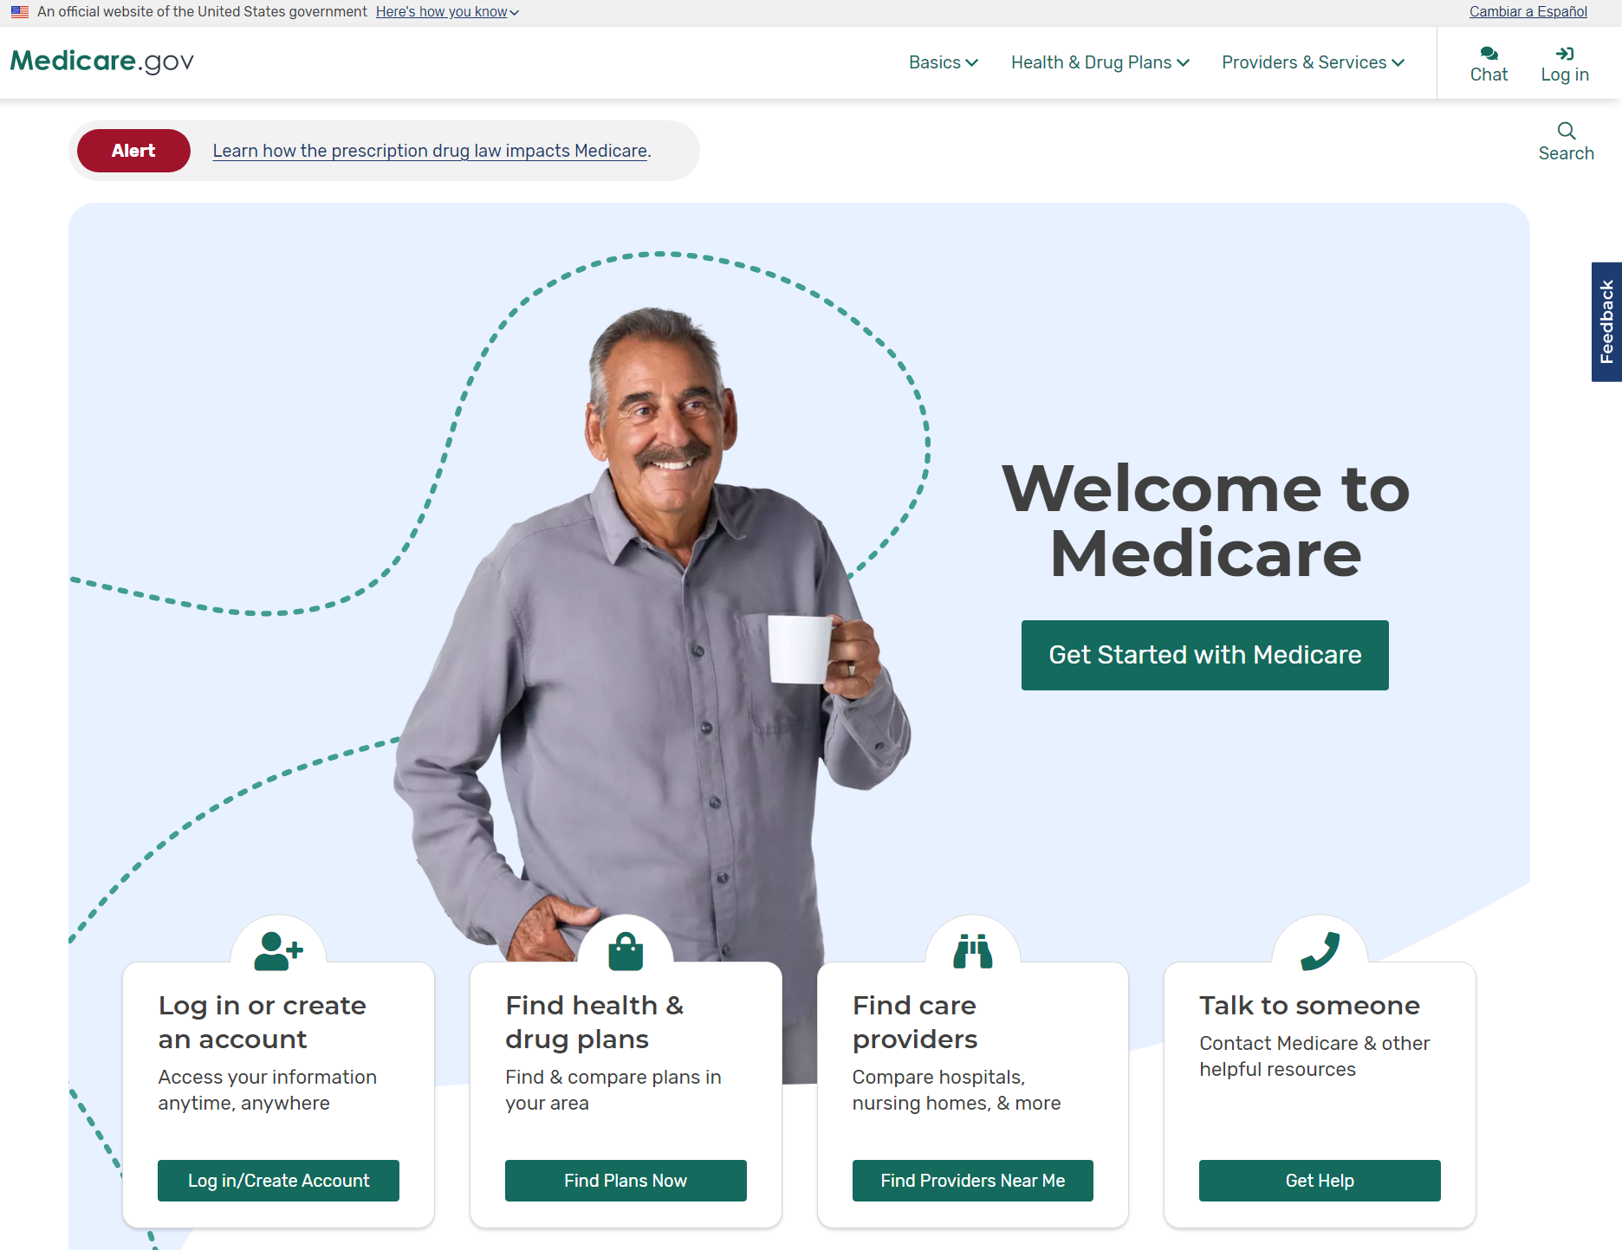
Medicare.gov
1-800-MEDICARE or Medicare.gov
Notes:
Please keep in mind that although you apply for Medicare by contacting Social Security, and we have some Medicare information on our website, it is actually another federal government agency, Centers for Medicare & Medicaid Services, commonly referred to as “CMS” that administers the program. CMS is your main source for information regarding Medicare.
Social Security helps you apply for Medicare Parts A and B, and we send your entitlement information electronically to CMS.
We can also take your application for Extra Help with Medicare Part D.
If you sign up for Part B, we deduct the premium from your monthly Social Security benefit – and send it to CMS – before you receive your payment from us each month.
If you enroll in Medicare only, CMS will bill you for your Part B premiums until you go on Social Security.
If you have any questions regarding the Medicare program, you can call CMS at 1-800-MEDICARE or visit Medicare.gov
Your State Health Insurance Assistance Program (SHIP) can help answer any Medicare questions you may have. To get the phone number for your local SHIP office, visit shiphelp.org or look in your “Medicare & You” handbook. For more information about Medicare, please visit Medicare.gov or call 1-800-MEDICARE (1-800-633-4227). TTY users can call 1-877-486-2048.
Speaker Notes updated: OISP/OEEMP – 10/13/2022 (SY/JP)
Slide updated 4/12/2023 (SY/JP)

Slide 27
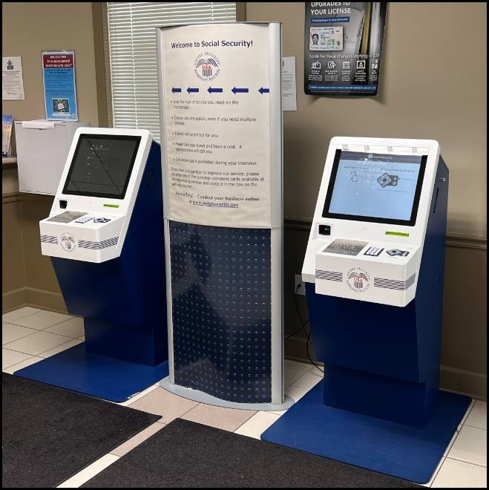
What To Know If You Must Visit An Office
Our Mobile Check-In Express feature makes it easier to check-in if you must visit a Social Security office. Scan the QR code located at your local Social Security office to check-in for your visit.
If you’re unable to check-in on your mobile device, we offer private, accessible check-in with our Americans with Disabilities Act (ADA) compliant kiosks in most of our local Social Security offices.
Notes:
Slide added 7/8/2024 (LF/SY)

Slide 28
Key Updates
Changes to Accessing Our In-Person Services
Effective January 6, 2025, customers wishing to conduct business with their local Social Security office will need to schedule an appointment.
By scheduling appointments, we can serve the public more efficiently by:
Reducing wait times
Streamlining service delivery
Improving overall customer experience
Customers can also receive services by utilizing our:
Online services where many transactions can be completed conveniently and securely, and
Automated services available on our National 800# at 1-800-772-1213
Notes:
Reference:
EM 24059
ssa.gov/news/advocates/2024/#2024-11-13
Slide added 12/4/2024 (K/J/SY)

Slide 29



File online for Retirement, Spouse, Disability, or Medicare Only
If you are disabled, you can file for Retirement and Disability with same application if you are at least 62 but not yet FRA.
Survivor* application is not available online.
Schedule phone appointment at 1-800-772-1213, 8 a.m. – 7 p.m. Monday through Friday.
Schedule in-office appointment at 1-800-772-1213.
*Child and survivor claims can only
be done by phone or in office.
Notes:
You can apply for your Social Security within 4 months of when you want your benefits to begin.
You have three options, when it comes time to file:
Apply online at ssa.gov. This is the most convenient way to apply.
Call Social Security to schedule an appointment to apply over the telephone on a day and time that is convenient for you.
Call Social Security to schedule an appointment to apply in-person at your local Social Security office with a face-to-face interview. Due to the Covid-19 pandemic, we can only provide in-person service by appointment only for limited, critical issues.
You cannot file online for auxiliary child’s benefits, disabled adult child benefits, or survivor’s benefits.
Applying online is still the most convenient way to apply for benefits. You can apply for retirement benefits in as little as 15 minutes.
Modified 800# hours added 1/5/2022 (JP)

Slide 30

Social Security Embraces Social Media
Discover us on Facebook, Twitter, YouTube, and Pinterest
Check out our blog, “Social Security Matters.”
Sign-up to get emails and SMS/Texting when we update popular www.socialsecurity.gov web pages

Slide 31

Q&A Session
Notes:
Option for speaker:
You can use this slide OR switch to the visual “Rotating Brand Images” presentation found on the PARC as a scrolling visual while answering questions.
Rotating Brand Images PowerPoint: https://eis.ba.ssa.gov/crc/parc/marketing/audiences/general/UniversalPowerPoint.html

