Slide 1
Tribal Outreach and Education

Slide 2
MEDICAID/CHIP DEFINITION OF INDIAN
For the purpose of Medicaid & CHIP, the definition of Indian is defined as any American Indian and Alaska Natives eligible for services from an Indian Health Care provider

Slide 3
MEDICAID AND CHIP PROTECTIONS
Do not have to pay Medicaid premiums or enrollment fees if they are eligible to receive care from the Indian Health Care providers or through referral to a non-Indian provider such a Purchased/Referred Care
Do not have to pay cost sharing, such as deductibles, coinsurance or copayments for any Medicaid service from any Medicaid provider if they have ever received a service or referral from and Indian Health Care provider
Children who are American Indian/Alaska Native cannot be charged any premium, enrollment fee, copayment, coinsurance or deductible in CHIP
Certain types of Indian payments and resources are not counted when determining Medicaid and CHIP eligibility
Certain types of Indian trust income and resources are exempt from Medicaid estate recovery rules

Slide 4
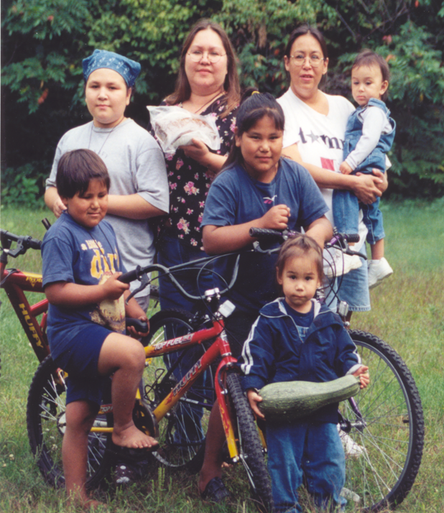
MEDICAID/CHIP BENEFITS
No Copays, Deductibles, Co-Insurance, Premiums for AI/ANs
Enroll Year Around
Non-emergency Transportation
Transitional Medicaid Assistance
Family Planning
Primary, Preventive, Dental Care, Vision Care
Physical, Occupational, Speech, Language therapies

Slide 5
EPSDT
Early and Periodic Screening, Diagnostic and Treatment
EPSDT at its heart is all about early identification and intervention. It makes Medicaid align with pediatric best practice in providing care to children.
The mandate requires State Medicaid Programs to adopt best practices in early screening of infants/toddlers/children/youth to identify health and developmental issues
Developmental screening at 9 months, 18 months and 30 months
Early screening for vision and dental problems
And States have to report on their screening statistics so there’s the effect of knowing your state is being judged on where it ranks in addressing children needs
The other piece of EPSDT being valuable is the Treatment mandate
Once a diagnosis is made, the state is obligated to get the child treatment. Additionally, the State is responsible to arrange for services even if the services fall outside of what the State typically pays for—i.e. massage therapy, chiropractic, etc.

Slide 6
CHALLENGES
Mail delivery to P.O. boxes
Access to technical assistance
Staying up-to-date on the latest CMS announcements
Understanding changes in health laws and flexibilities
Complex application process
Geographical issues: remote or isolated
Lack of transportation
Limited or no internet connection
Working with state Medicaid agency
Submission of supporting documents
Notes:
Tribal community outreach and engagement involves building meaningful connections and collaborative relationships with indigenous tribal communities. It is essential for understanding their unique needs, culture, and history. Here are some recommended practices for effective engagement:
Be Consistent and Persistent: Recognize that building relationships with tribal entities can be complex and slow. Understand that tribal communities have distinct histories with outside forces, and initial interactions may feel distant. Be consistent, persistent, and respectful in your efforts to engage.
Acknowledge Leadership Diversity: Most tribal communities have both elected and traditional leaders. Elected leaders make major decisions affecting tribal members, while traditional leaders hold cultural knowledge and history. As an outsider, identify the appropriate person to engage with based on the context¹.
Respect Tribal Sovereignty: Tribal sovereignty is crucial. Understand that each tribe has its own language, governing style, traditions, and spirituality. Approach engagement with humility and respect for their autonomy.
Learn and Listen: Take the time to learn about the specific tribe’s history, customs, and challenges. Active listening is essential. Engage in dialogue to understand their perspectives and needs.
Build Trust: Trust is foundational. Demonstrate integrity, transparency, and consistency. Actions matter, even when you
think no one is watching¹.
Remember that these practices are just a starting point, and each tribal community is unique. Effective engagement requires ongoing learning, cultural sensitivity, and a commitment to building bridges of understanding and collaboration.

Slide 7
LESSONS LEARNED
Tribal enrollment assisters understand the unique enrollment requirements and application process for Tribal citizens
Foster strong partnership with other enrollment assisters
Build relationships with organizations in the community
Outreach materials customized to fit Tribal communities
Social media is a useful tool for outreach and education
Sharing health insurance enrollment experiences
Understanding the Tribal community’s culture, history, and traditions
Communication is unique in Tribal communities

Slide 8
BEST PRACTICES
Utilizing enrollment data
Navigating social media
Partnering with community organizations or organizations with outreach grants
Internal training at Indian Health Service and Tribal facilities
Placing Tribal enrollment assisters at different departments
Running internal reports on uninsured
Receiving data sharing from state Medicaid
Involving internal staff by using their reach
Being visible
Elders are the greatest teachers and messengers

Slide 9
EXAMPLES OF OUTREACH AND EDUCATION
PRINT | ELECTRONIC | VISUALS | PERSONAL CONTACT
Fact sheets | Social Media | Signage | Meetings
Brochures | Websites | Posters | Community events
Flyers | Electronic News | Banners | Target audience
Newsletters | Emails | Presentations | Partner organization
News releases | Public Service Announcements | Exhibit displays | Word of Mouth
Mail | Bulletin Boards |  | CHR/WIC
 | Texting

Slide 10
12 Months of Mandatory Continuous Coverage for Children in Medicaid/CHIP
On September 29, 2023: The U.S. Department of Health and Human Services, through the Centers for Medicare & Medicaid Services (CMS), sent a letter to state health officials reinforcing that states must provide 12 months of continuous coverage for children under the age of 19 on Medicaid and the Children’s Health Insurance Program (CHIP) beginning January 1, 2024.
This means that children who enroll in Medicaid or CHIP are guaranteed 12 months of continuous coverage even if their household’s circumstances change, preventing gaps in coverage and periods of uninsurance due to income fluctuations or missed paperwork.

Slide 11
National Native Harm reduction summit
MEDICAID ANNOUNCEMENT
12 Months of Mandatory Continuous Coverage for Children in Medicaid and CHIP
On September 29, 2023: The U.S. Department of Health and Human Services, through the Centers for Medicare & Medicaid Services (CMS), sent a letter to state health officials reinforcing that states must provide 12 months of continuous coverage for children under the age of 19 on Medicaid and the Children’s Health Insurance Program (CHIP) beginning January 1, 2024.
This means that children who enroll in Medicaid or CHIP are guaranteed 12 months of continuous coverage even if their household’s circumstances change, preventing gaps in coverage and periods of uninsurance due to income fluctuations or missed paperwork.aperwork.
Notes:
​Currently 33 states offer continuous eligibility to at least some. As of January 1, 2024, all states are required to provide 12 months of continuous health coverage for children in Medicaid and the Children’s Health Insurance Program (CHIP). This reduces the risk of eligible children losing coverage due to administrative barriers or temporary fluctuations in family income. In 2022, Oregon became the first state approved to take this policy option a step further by providing multi-year continuous coverage to young children from birth up to age 6. Since then, several states began developing or implementing their own multi-year continuous eligibility programs.
Oregon received first-in-the-nation approval in September 2022 to provide CE to children from birth through age 5, as well as 24-month CE for individuals ages 6 and older.
Similar to Oregon, Washington received CMS approval to provide CE to children from birth through age 5.
Massachusetts received CMS approval in August 2023 to offer 24-month CE to children and adults experiencing homelessness and 12-month CE to youth and adults following release from correctional institutions.
New Mexico received approval in December 2023 to provide CE to children from birth through age 5.

Slide 12
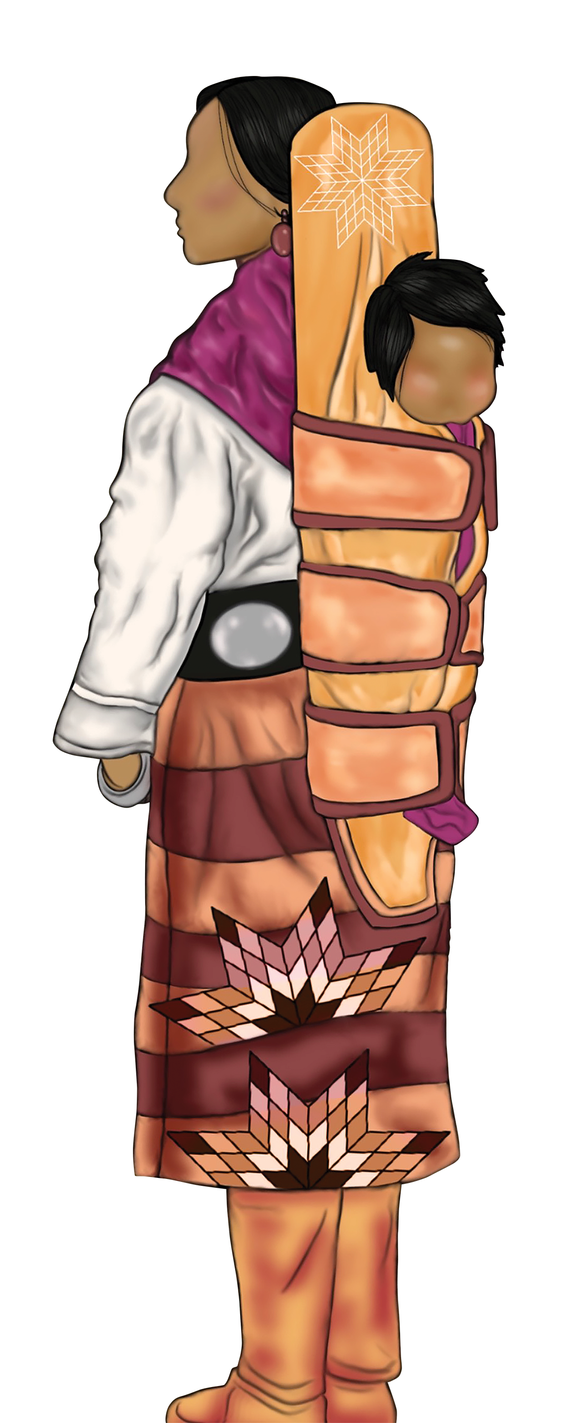
Medicaid Postpartum Coverage
As of April 1, 2022, the American Rescue Plan Act of 2021 allowed states the option to extend Medicaid postpartum coverage from 2 to 12 months

Slide 13
MARKETING & COMMUNICATIONS OVERSIGHT IMPROVEMENTS FOR PLAN YEAR 2024
MA Organizations can’t:
Advertise benefits that aren’t available to beneficiaries in the service area(s) where the marketing appears
Market any products or plans, benefits, or costs, unless the MA organization or marketing name(s) as listed in HPMS of the entities offering the referenced products or plans, benefits, or costs are identified in the marketing material
Advertise about savings available that are based on a comparison of typical expenses for uninsured individuals, unpaid costs of dually eligible beneficiaries, or other unrealized costs of a person with Medicare

Slide 14
National Native Harm reduction summit
Ai/an marketplace open enrollment in the us
Notes:
The chart shows the marketplace open enrollment over the past seven years for American Indians and Alaska Natives in the US. The amount of missing race data has increased over the years, from 30% unknown race in 2019 to 50% in 2025. So, it is best to look at the trend and not look at the total numbers since we know this is not ALL AI/ANs who have enrolled in the marketplace, since there is so much missing data. In this case, we see the trend is that more AI/ANs have been enrolled in the marketplace from 2019 (pre-COVID) to 2025.
The source for these data is CMS

Slide 15
National Native Harm reduction summit
Health Insurance Marketplace AI/AN Open Enrollment
Notes:
This graph shows the data available for AI/AN Open Enrollment for California and Nevada.
The top line shows AI/AN marketplace enrollment for California. From 2019 to 2025, marketplace enrollment increased by 30%., California’s rate of missing race has actually gone down over time, from 28% in 2019 to 19% in 2025. But even so, we should focus more on the trend of the data, which is an increase in the number of AI/ANs in California who are enrolled in the Marketplace.
The bottom line on the chart is Marketplace enrollment for AI/ANs in Nevada. AI/AN marketplace enrollment also increased by about 30% in Nevada. Nevada’s rate of missing race has gone up and down since 2019, but in 2025, about 32% of marketplace consumers were missing race data.

Slide 16
National Native Harm reduction summit
Enrollment data
All data following are from American Community Survey 2013, 2018, and 2023 5-year estimates, U. S. Census Bureau.
All population data include foreign-born. American Indian Alaska Native is defined as “alone or in combination with one or more other races.”
Any questions on data, please contact Jeannie Le, Tribal Health Data Project Analyst and Rochelle Ruffer, Tribal Health Data Project Director at data@nihb.org.

Slide 17
National Native Harm reduction summit
AI/AN Enrollment in the United States
AI/AN Enrollment | 2013 | 2023 | Change | Percentage Change
Medicaid | 1,443,631 | 2,287,100 | 843,469 | 58.4%
Medicare | 583,116 | 949,303 | 366,187 | 62.8%
Uninsured | 1,216,197 | 1,029,407 | -186,790 | -15.4%
Notes:
The next set of slides will show the total enrollment in Medicaid, Medicare, and then Uninsured.
First, let’s look at the United States. The general trend is that AI/AN Medicaid and Medicare enrollment increases over the time frame. And the number of AI/AN uninsured falls. You can see that Medicaid AI/AN enrollment grew by almost 60% over this time period, Medicare AI/AN enrollment grew by over 60% in the last ten years, and the AI/AN uninsured rate fell by over 15%. However, we know that these numbers only tell part of the story since it doesn’t take into account what is happening to population over this time period. Instead, we should look at enrollment rates (enrollment as a percentage of the population), which we will do after looking at the enrollment for each of the three areas: Medicaid, Medicare, and then Uninsured.

Slide 18
National Native Harm reduction summit
AI/AN Medicaid enrollment
State | 2013 | 2023 | Change | Percentage Change | Medicaid Expansion Date
California | 186,214 | 362,685 | 176,471 | 94.8% | 1/1/2014
Nevada | 10,289 | 23,399 | 13,110 | 127.4%
Notes:
See the chart above to see the growth in Medicaid coverage of AI/AN from 2013 to 2023.
For both states, the number of AI/ANs enrolled in Medicaid increased over this time period. It’s interesting to note that both states also implemented Medicaid expansion early on, in January of 2014.

Slide 19
National Native Harm reduction summit
AI/AN Medicare enrollment
State | 2013 | 2023 | Change | Percentage Change
California | 75,666 | 137,269 | 61,603 | 81.4%
Nevada | 5,974 | 11,837 | 5,863 | 98.1%
Notes:
This table shows the absolute number of AI/AN enrolled in Medicare from 2013 to 2023. Note the growth in Medicare enrollment over the time period. These charts don’t consider the growth in population as well. These enrollment numbers are also for ALL AI/AN, even those who are under 65 but qualify for Medicare in the special categories, such as disability, permanent kidney failure,

Slide 20
National Native Harm reduction summit
AI/AN uninsured
State | 2013 | 2023 | Change | Percentage Change
California | 138,355 | 97,773 | -40,582 | -29.3%
Nevada | 14,225 | 13,816 | -409 | -2.9%
Notes:
This chart shows the number of AI/ANs uninsured for 2013 and 2023. The number of uninsured AI/ANs decreased in both states, although significantly less so in Nevada compared to California (about 3% decrease in Nevada compared to 30% in California). Again, these charts only show the change in number of AI/ANs enrolled, and do not take into account any changes in the overall population size. To compare change in enrollment relative to the size of the population, we will take a look at enrollment rates next.

Slide 21
Enrollment Rates by States
For the United States, California, and Nevada
Notes:
Next, we will look at enrollment rates for Medicaid, Medicare, and the Uninsured rate for AI/ANs by state. These graphs are part of a report that NIHB produces of annual health insurance enrollment data for American Indians/Alaska Natives. The report utilizing 2023 American Community Survey data should be available by the end of this summer and will show more detailed information include dual enrollment in Medicaid and Medicare, as well as enrollment rates broken down by age group.

Slide 22
United States: From 2013-2023, the AI/AN Uninsured rate decreased, and AI/AN Medicaid and Medicare enrollment rates increased.
Notes:
The chart above shows the AI/AN enrollment rates for Medicaid in blue, the AI/AN enrollment rate for Medicare in dark red, and the AI/AN Uninsured rate in orange.
Enrollment rates are calculated as the AI/AN total enrollment divided by the AI/AN population for each year.
We see, for the US overall, the Medicaid Enrollment rate grew from 28.2 percent of AI/ANs being enrolled in Medicaid in 2013 to 31.3% in 2023.
Similar, we see an increase of about 2 percentage points in the AI/AN Medicare enrollment rate from 11.4 % of the AI/AN population enrolled in Medicare in 2013 to 13% of the AI/AN population enrolled in Medicare in 2023.
And we see a decrease in the Uninsured rate from 23.8% of the AI/AN population in 2013 to 14.1 percent in 2023.

Slide 23
California: From 2013-2023, the AI/AN Uninsured rate decreased, and AI/AN Medicaid and Medicare enrollment rates increased.
Notes:
In California, the Medicaid enrollment rate increased sharply by 7 percentage points from 2013 to 2018, before falling slightly in 2023. But overall from 2013 to 2023, the Medicaid Enrollment rate for AI/Ans increased by 5.7 percentage points.
The uninsured rate starts in the middle of the graph at 20.2% in 2013 and falls by more than 11 percentages points to 8.9% in 2023.
And the Medicare enrollment rate rose slightly by 1.4 percentage points from 11.1% to 12.5%.

Slide 24
Nevada: From 2013-2023, the AI/AN Uninsured rate decreased, and AI/AN Medicaid and Medicare enrollment rates increased.
Notes:
Similar to California, we see a sharp increase of over 9 percentage points in the Medicaid enrollment rate in Nevada, from 2013 to 2018. The AI/AN Medicaid enrollment rate then falls by 3.4 percentage points from 2018 to 2023. Overall, the AI/AN Medicaid enrollment increases by 5.9 percentage points from 2013 to 2023 from 19.8 % to 25.7 %.
The AI/AN uninsured rate for Nevada starts as the top line at 27.3 percent in 2013. It falls by 12 percentage points from 2013 to 2018. Then, it basically stays the same in Nevada from 2018 to 2023.
The AI/AN Medicare enrollment rate increased by 3.5 percentage points from 2013 to 2018, before dropping by 2 percentage points from 2018 to 2023.

Slide 25
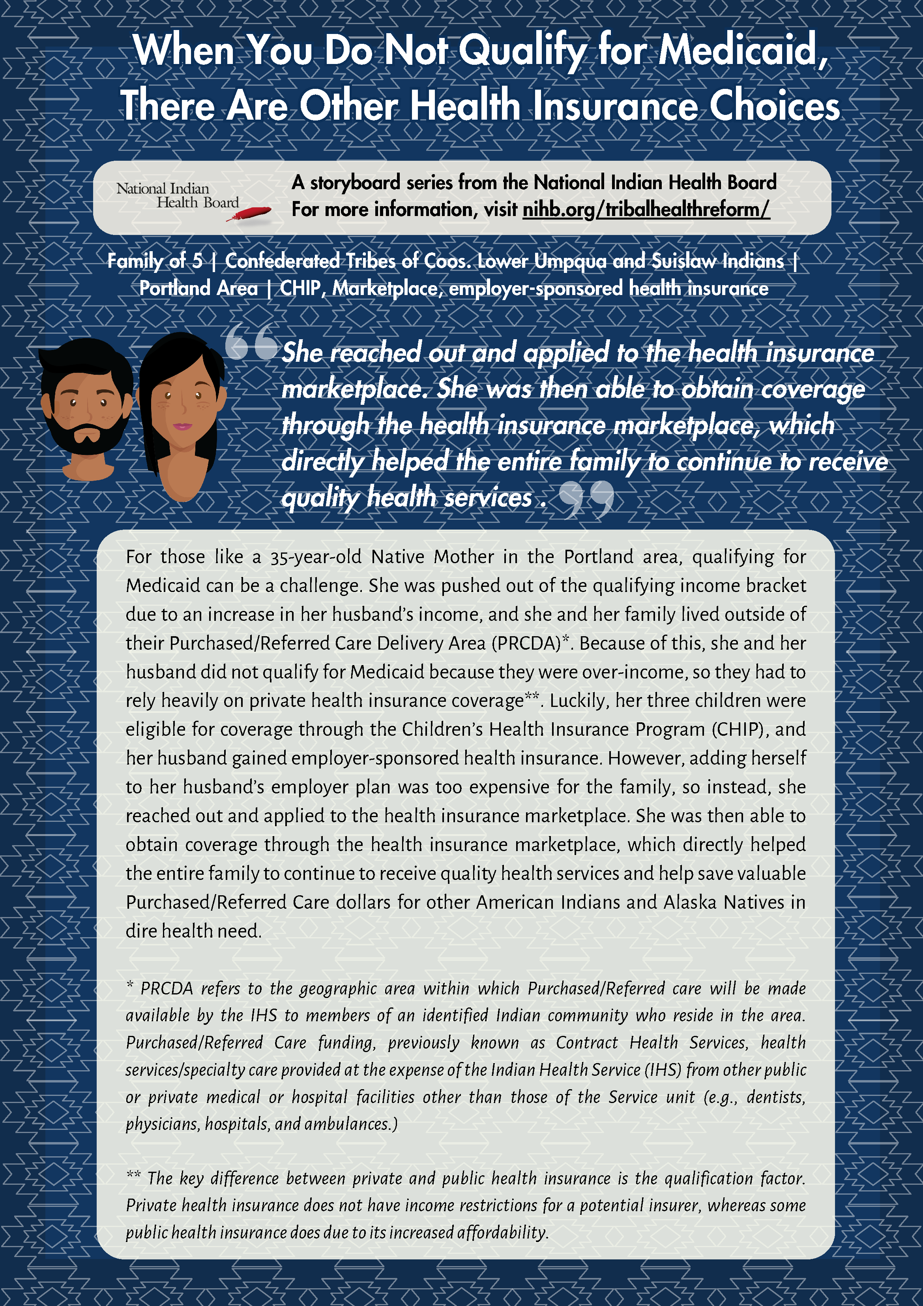
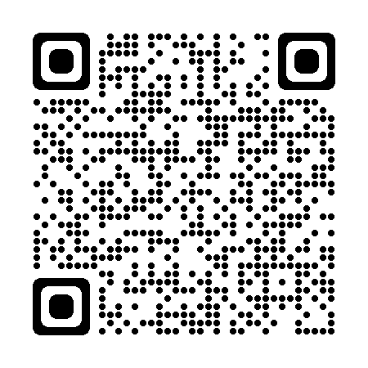
NIHB Story Boards

Slide 26
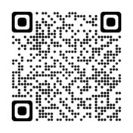
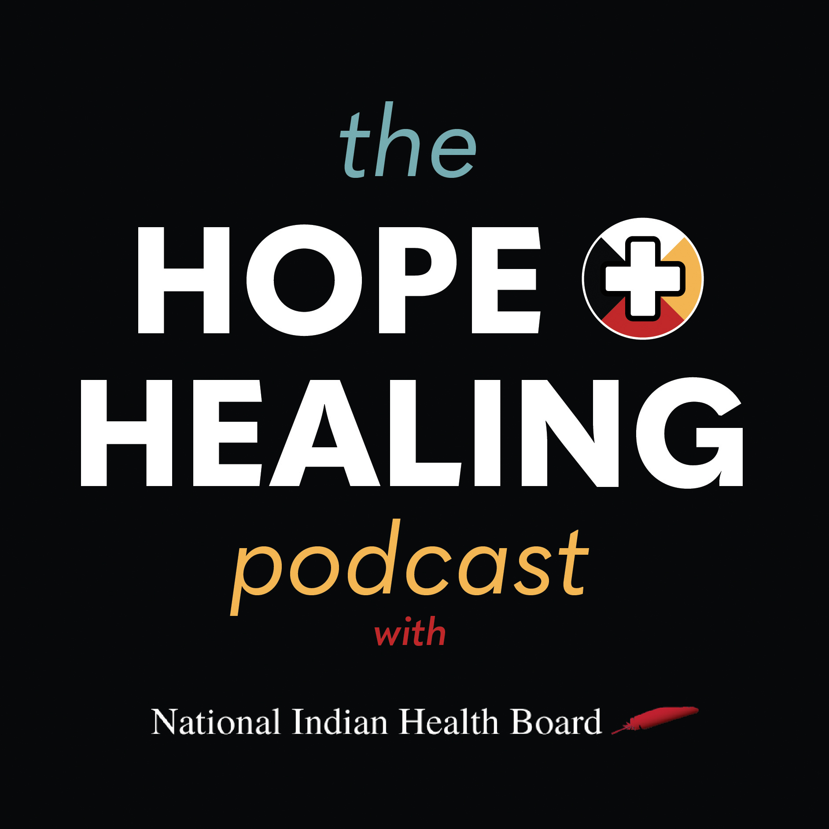
Season 2 in 2024: The Hope & Healing Podcast
Six Episode Series (Season 1):
Introduction | Kristen Bitsuie
Medicaid 101 | Angie Wilson
Medicare 101 | Adam Archuleta
Marketplace 101 | Yvonne Myers
Health Equity | Jim Roberts
Emerging Hot Topics | Melissa Gower & Winn Davis

Slide 27
Ahéhee’ (Thank you)
Kristen Bitsuie
Tribal Health Care Outreach and Education Policy Manager
kbitsuie@nihb.org
“It’s great to know that you can make any moment a learning opportunity.”
-unknown

